Slide 1
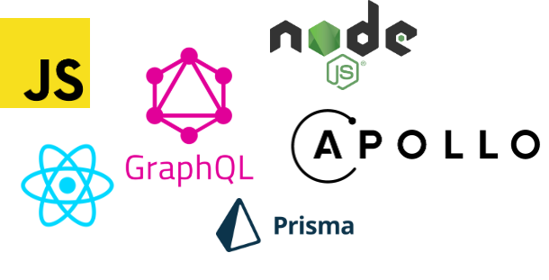
Fullstack with
GraphQL, Prisma, React and Apollo Boost

Slide 2



Somprasong Damyos
Technical Manager @Open Source Technology Co., Ltd.
@somprasongd
@somprasongd
@somprasongd

Slide 3
Agenda
Architecture
Build GraphQL Server
Data Access Layer with Prisma
Create Frontend App with React and Apollo Boost

Slide 4

Architecture

Slide 5
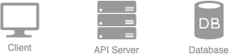
Typical 3-tier Architecture

Slide 6

Typical 3-tier Architecture

Slide 7
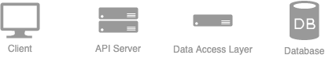
The Data Access Layer

Slide 8
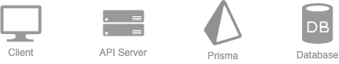
Prisma is the Data Access Layer

Slide 9
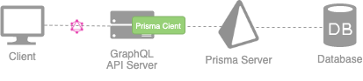
Architecture

Slide 10
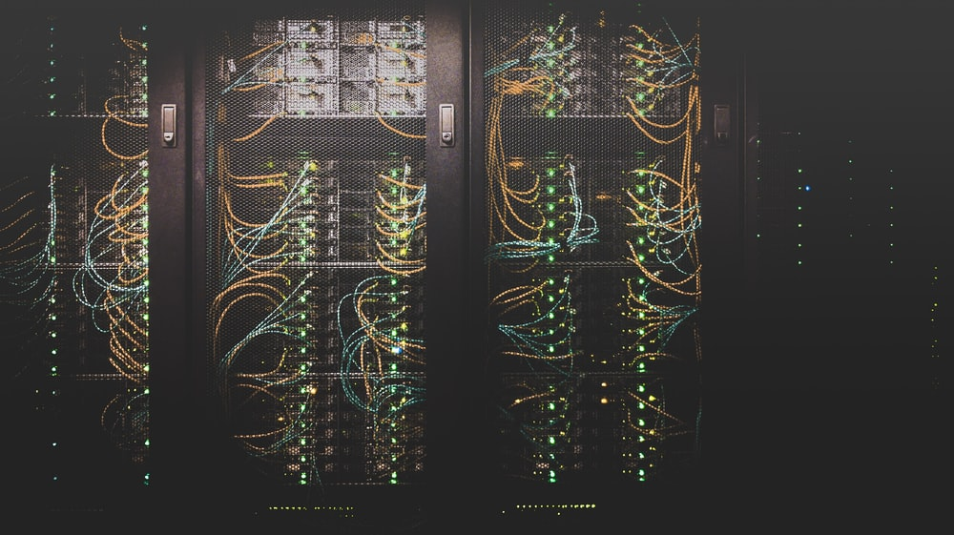
Build GraphQL Server

Slide 11
What is GraphQL?
New API standard developed by Facebook
Specification for type system & query language
Core primitives: Query, Mutation & Subscription

Slide 12
Rest vs GraphQL
Single vs Multiple Endpoint
Server vs Client decides how data return
Schemaless vs Schemaful

Slide 13
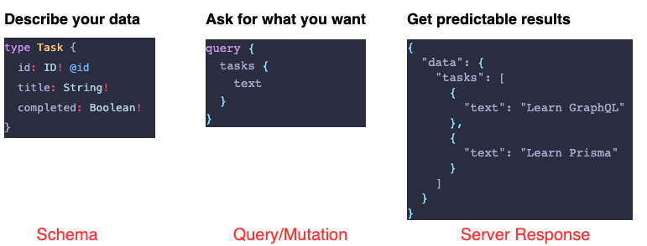
How GraphQL Works?

Slide 14
Understand GraphQL Servers
1. Definition: The GraphQL Schema
2. Implementation: Resolver Functions
3. Setup: Framework, Network (HTTP), Middlewares

Slide 15
1. The GraphQL Schema
Strongly typed & written in GraphQL Schema Definition Language (SDL)
Defines API capabilities (contract for client-server communication)
Used for: Auto-generated docs, codegen, automated tests, ...

Slide 16
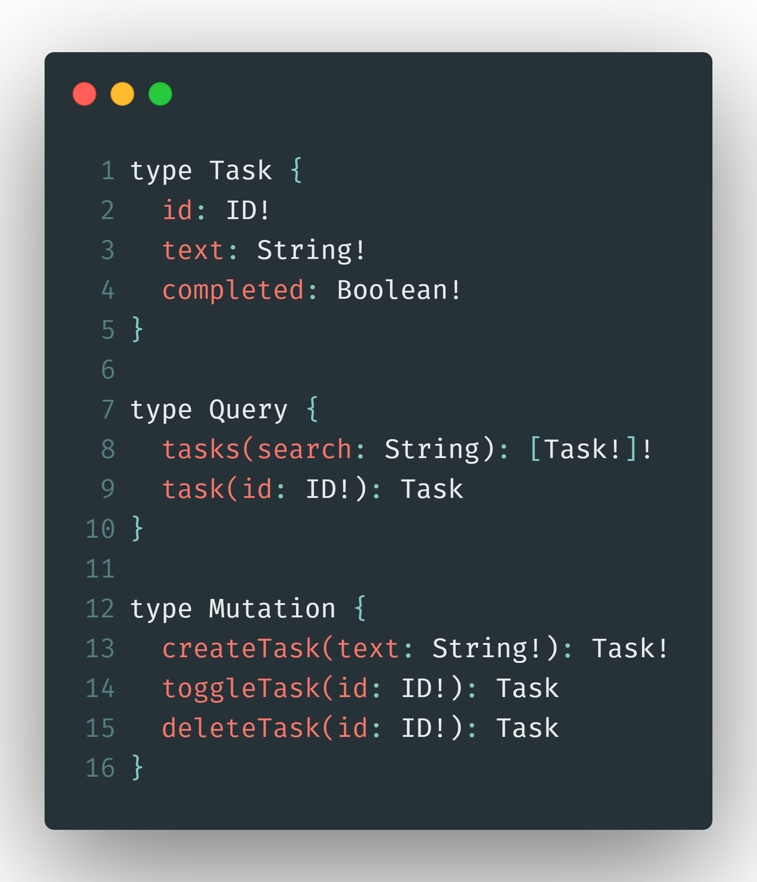

Slide 17
2. Resolver Function
Concrete implementation of the API
One resolver function per field in SDL schema
Query execution: Invoke resolvers for all fields in query

Slide 18
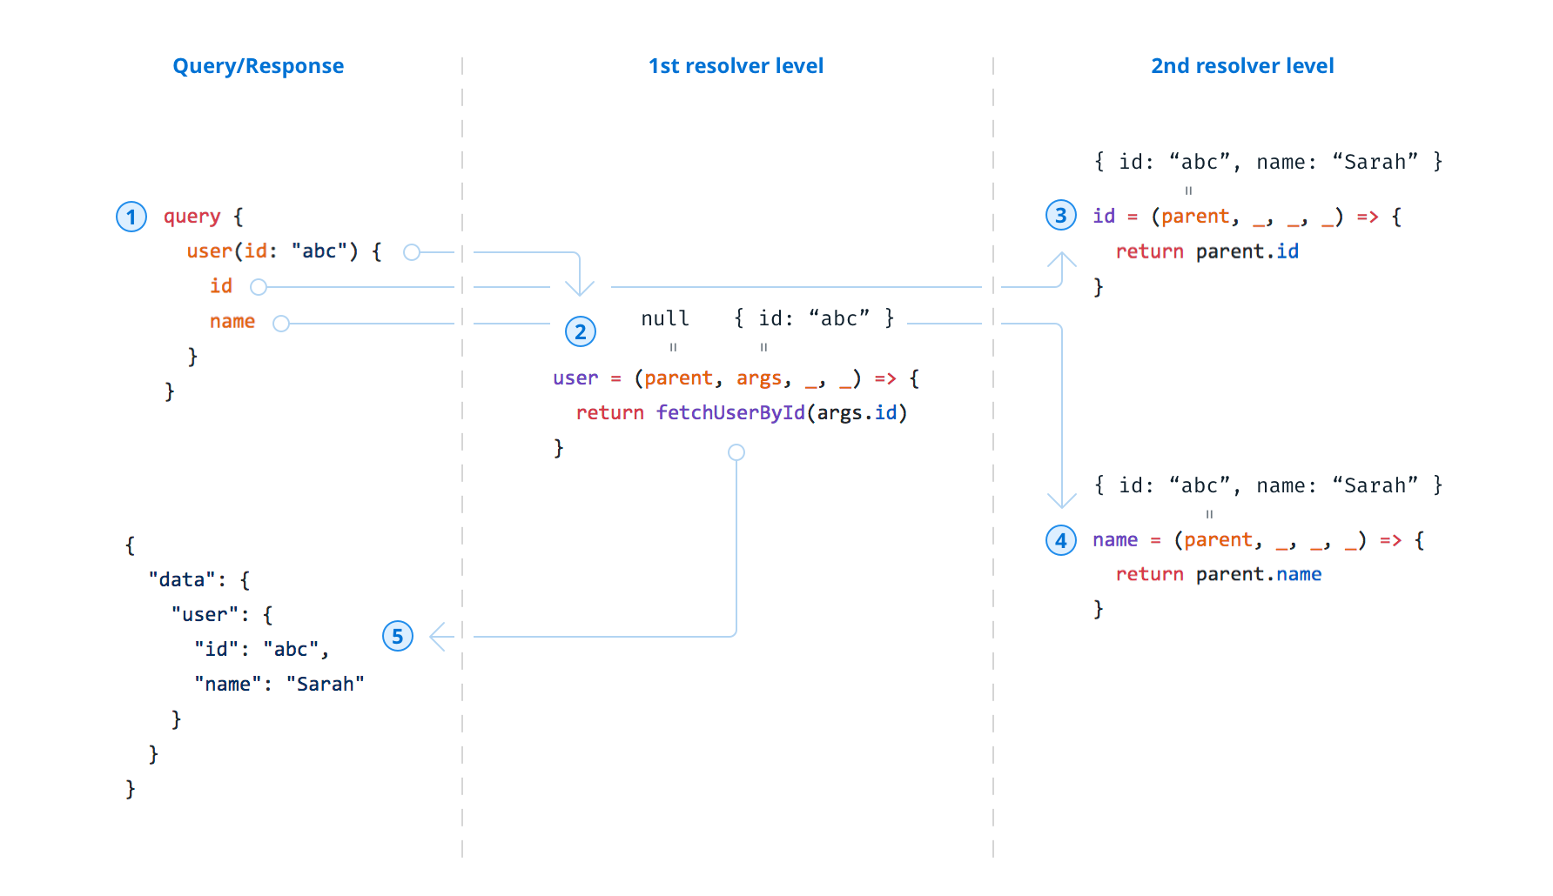

Slide 19
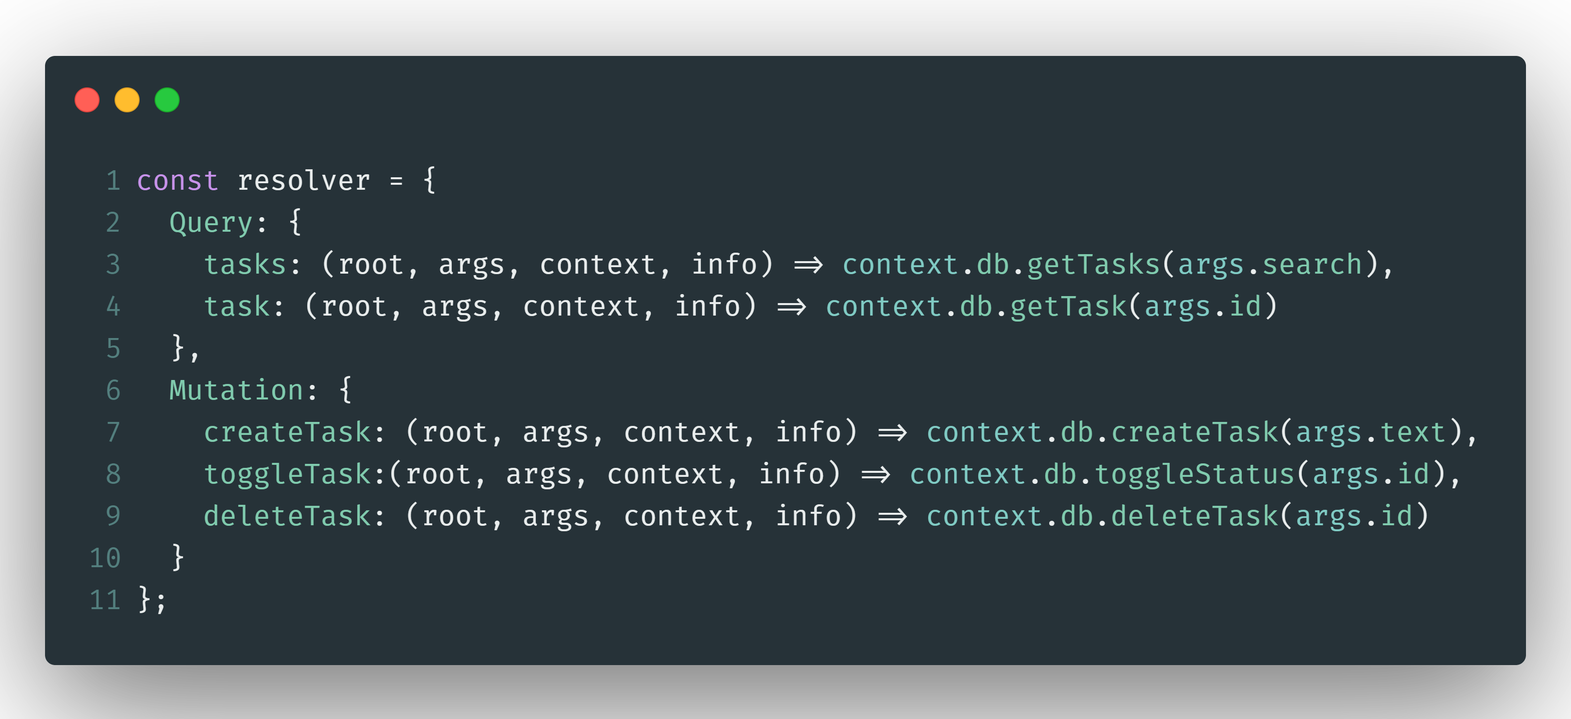

Slide 20
3. Setup
"GraphQL engine" to orchestrate resolver invocations
Network layer based on "graphql-yoga" (network configuration: port, endpoints, CORS ... )
Middleware (analytics, logging, crash reporting ... )

Slide 21
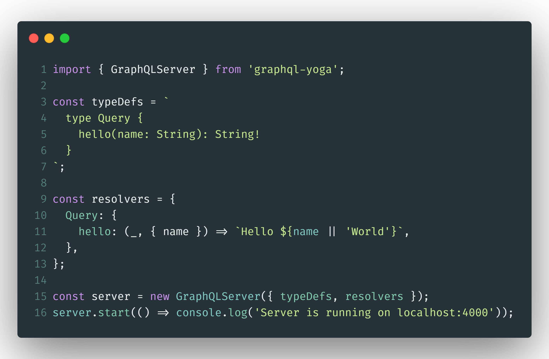

Slide 22
1. Schema

Slide 23
2. Resolver

Slide 24
3. Setup

Slide 25
Build GraphQL Server
mkdir todo-app
cd todo-app
git clone https://github.com/somprasongd/boilerplate-node-babel.git gql-server
cd gql-server
npm install graphql-yoga

Slide 26
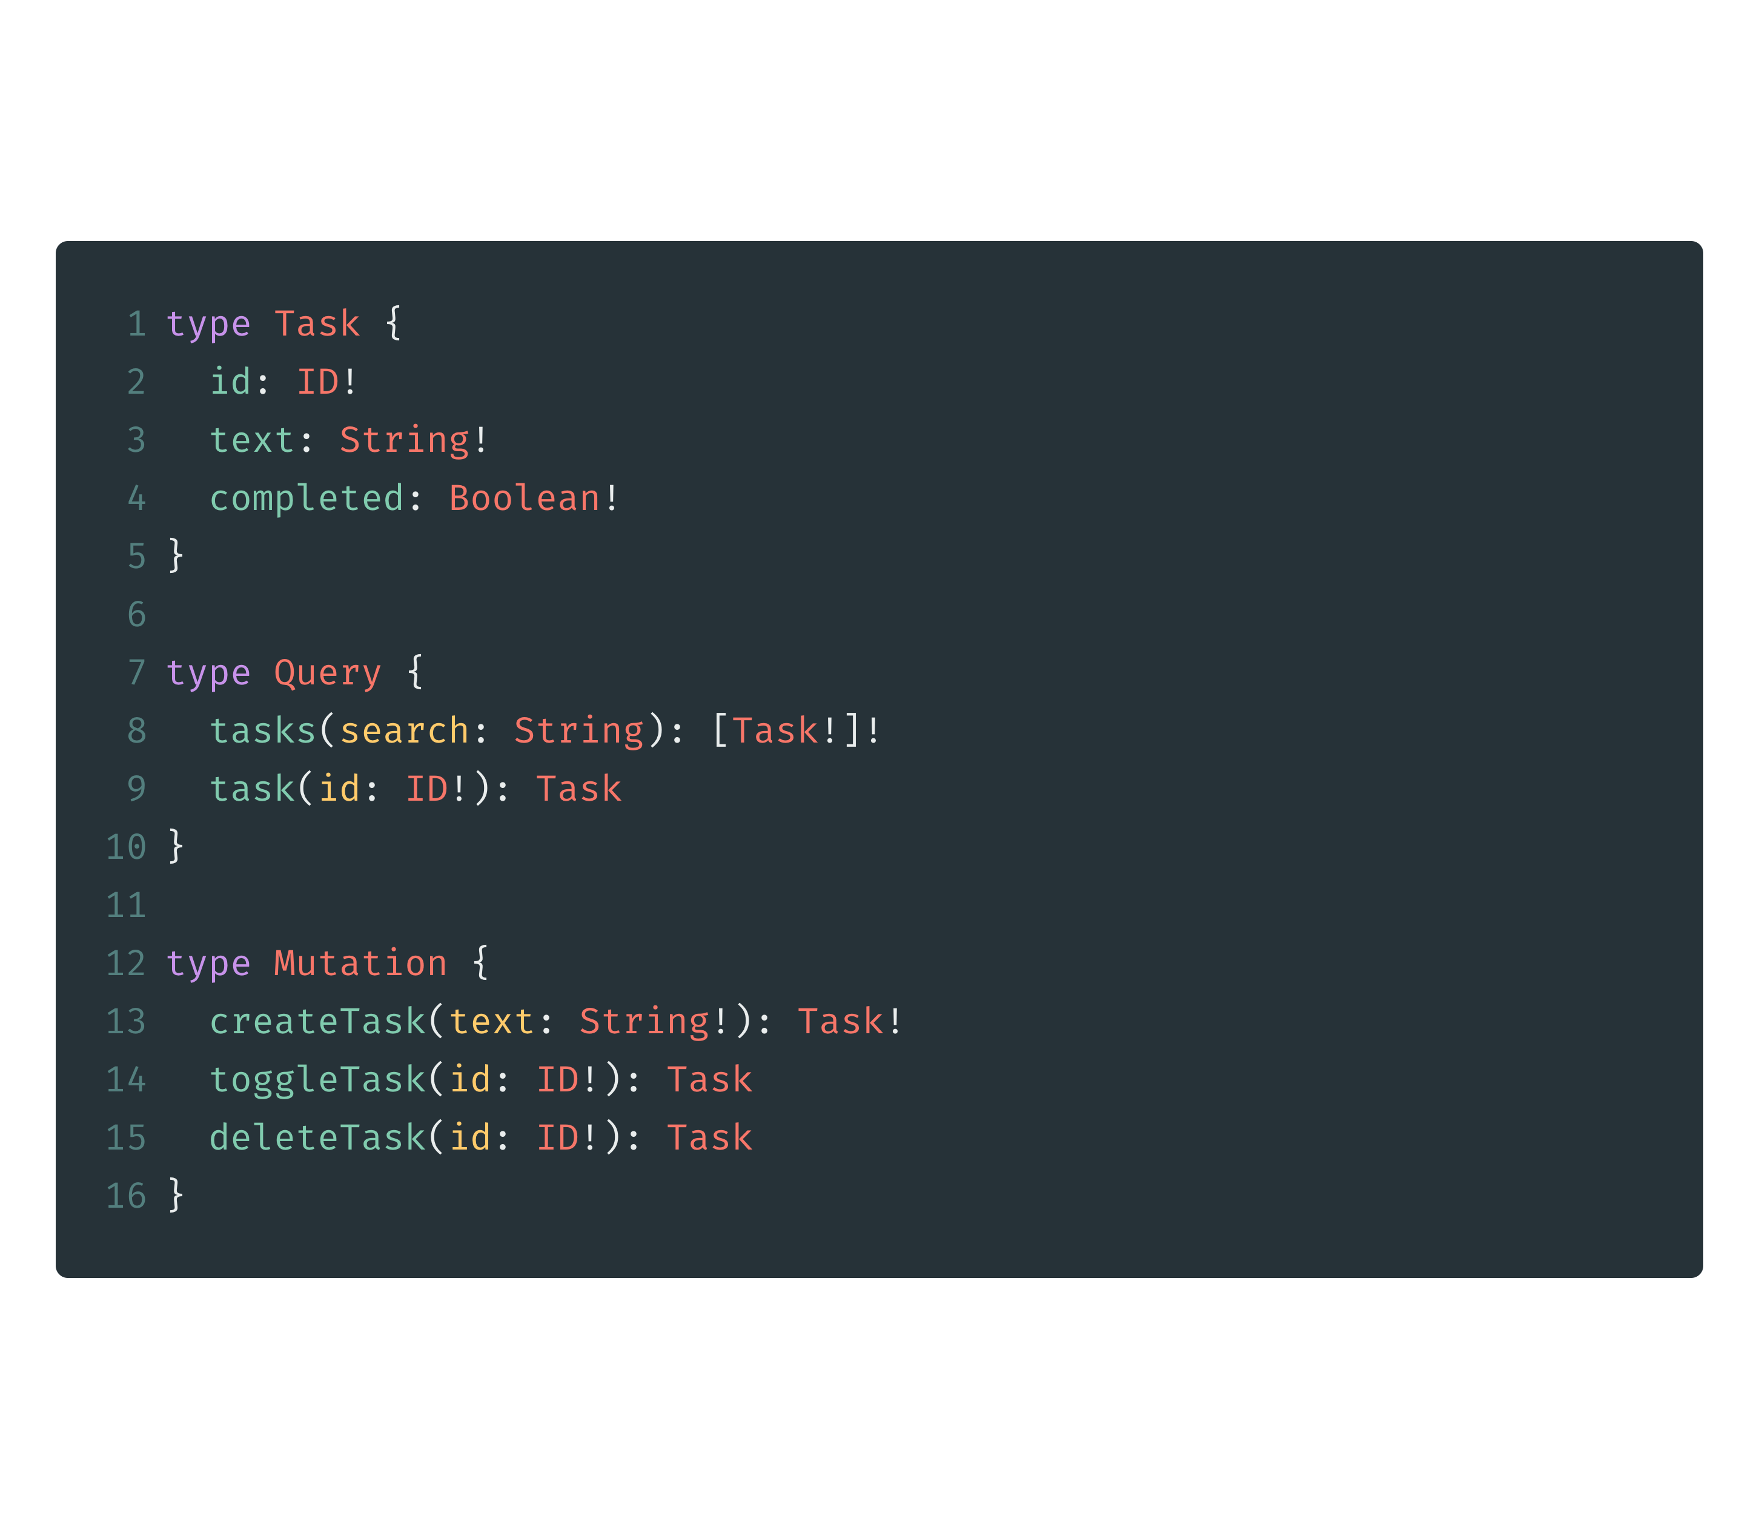
Build GraphQL Server
Notes:
https://gist.github.com/somprasongd/64578311cadc8388e21ae940701b9a0d

Slide 27
Query & Mutation
Query
Arguments
Mutation
Operation Name
Fragment
Alias
Variable
Directive

Slide 28
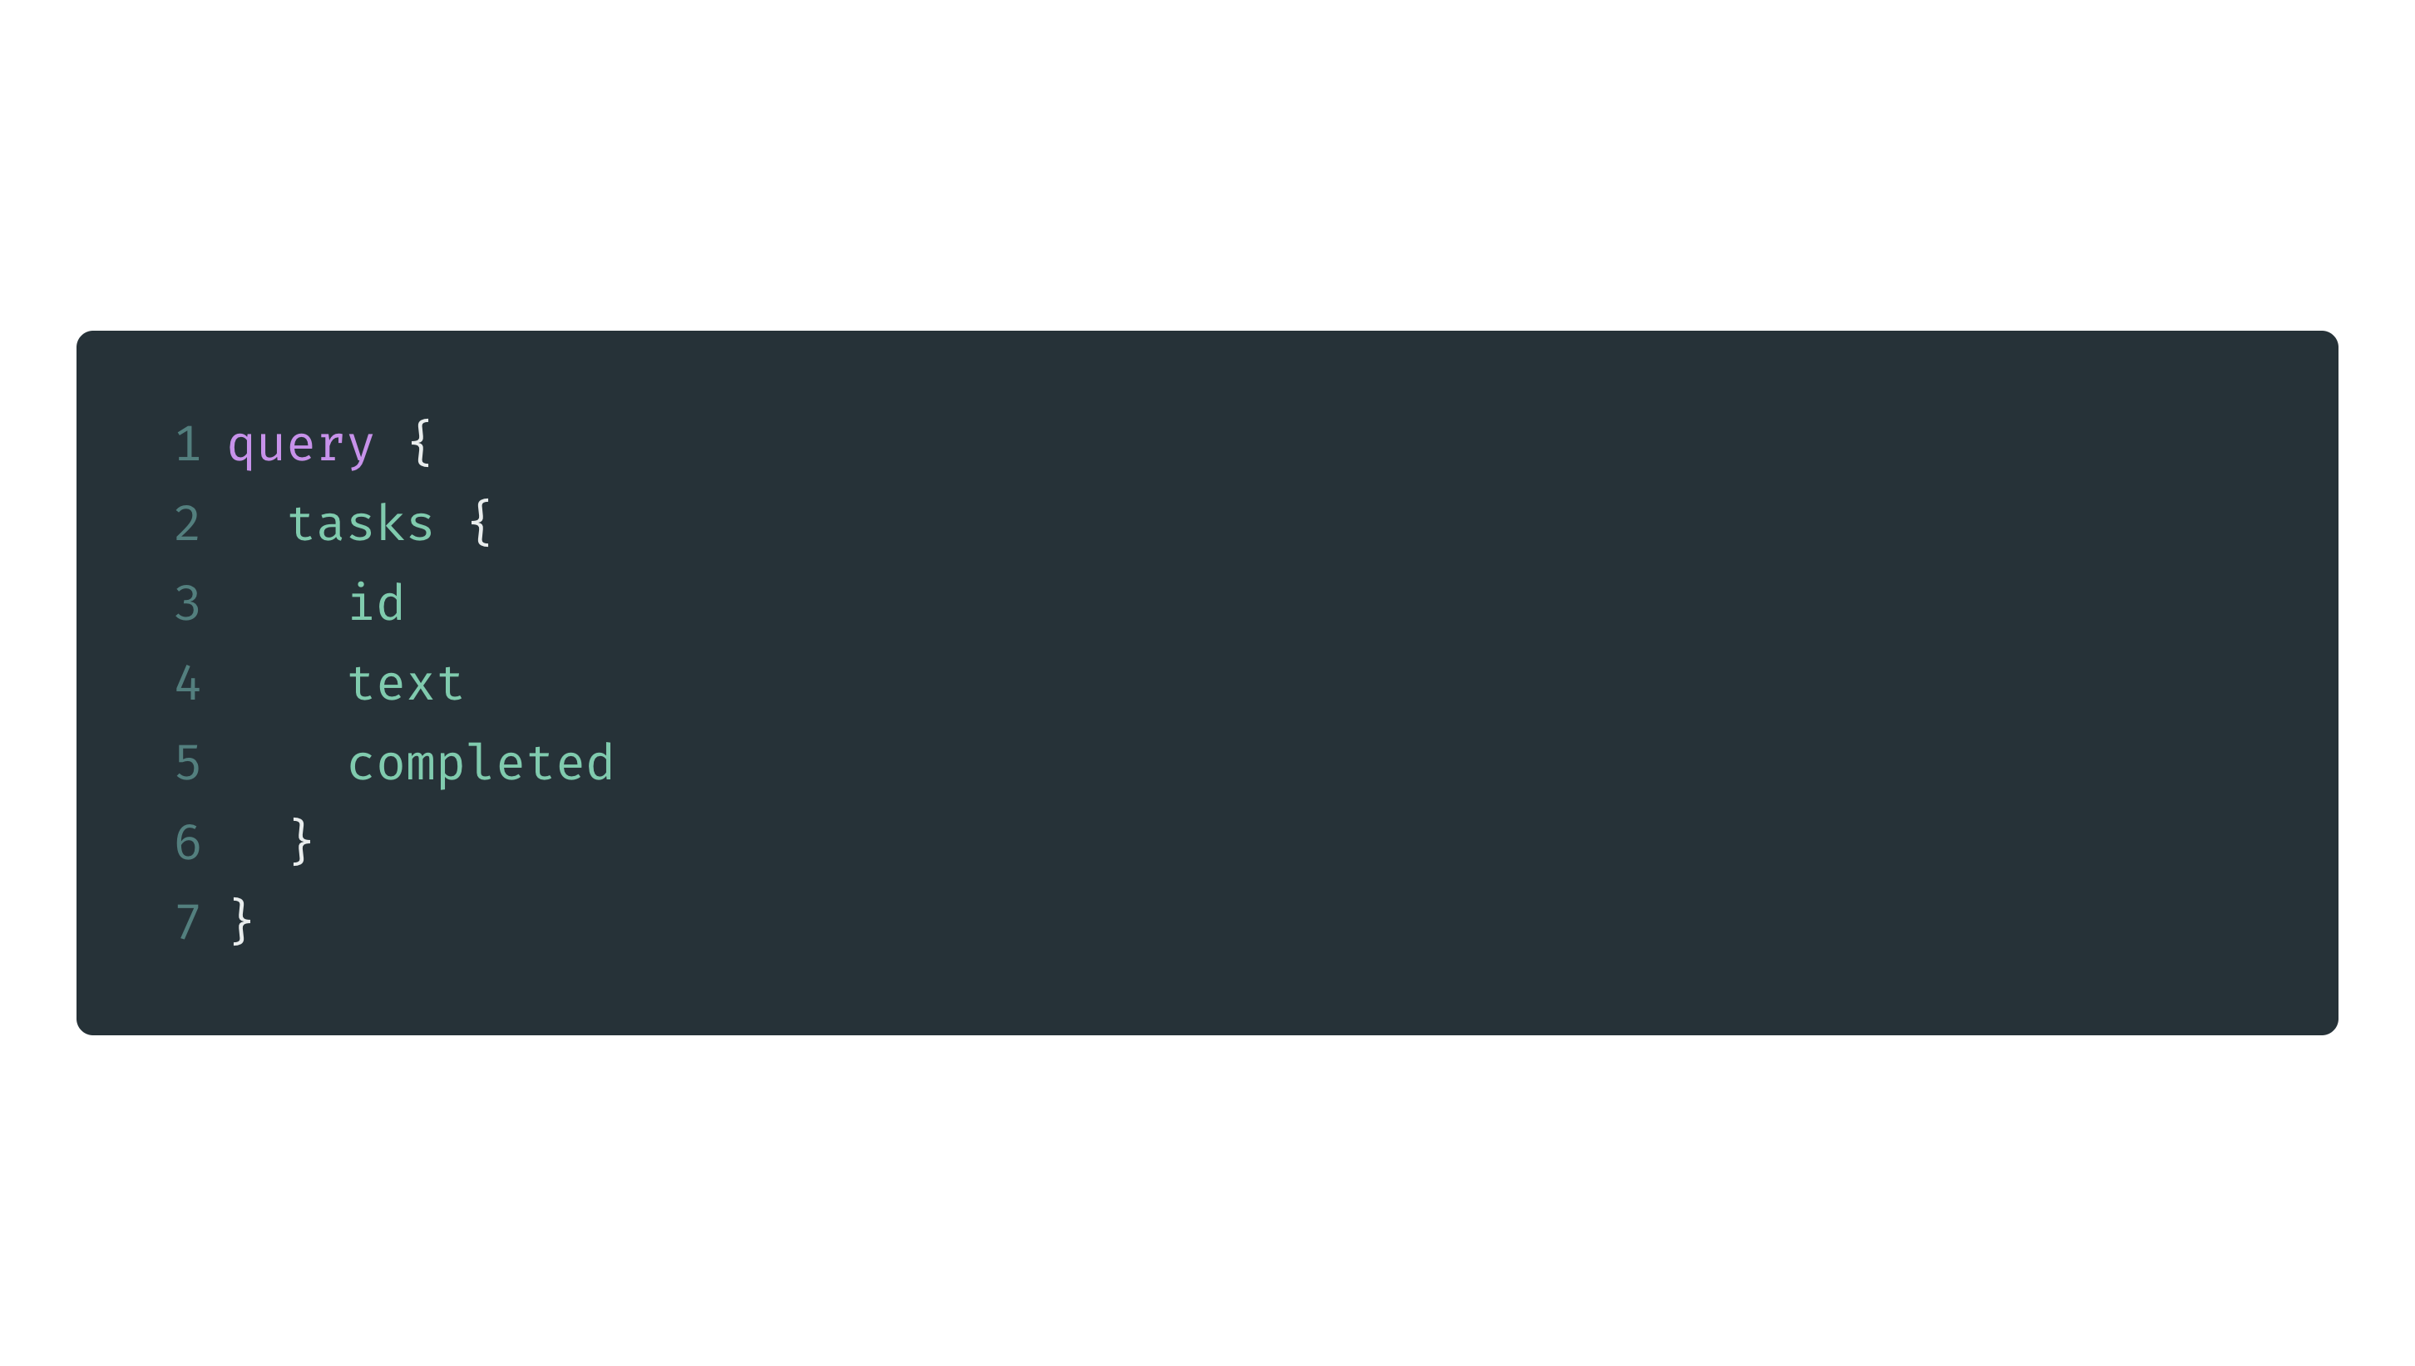
Query & Mutation
Query
Arguments
Mutation
Operation Name
Fragment
Alias
Variable
Directive

Slide 29
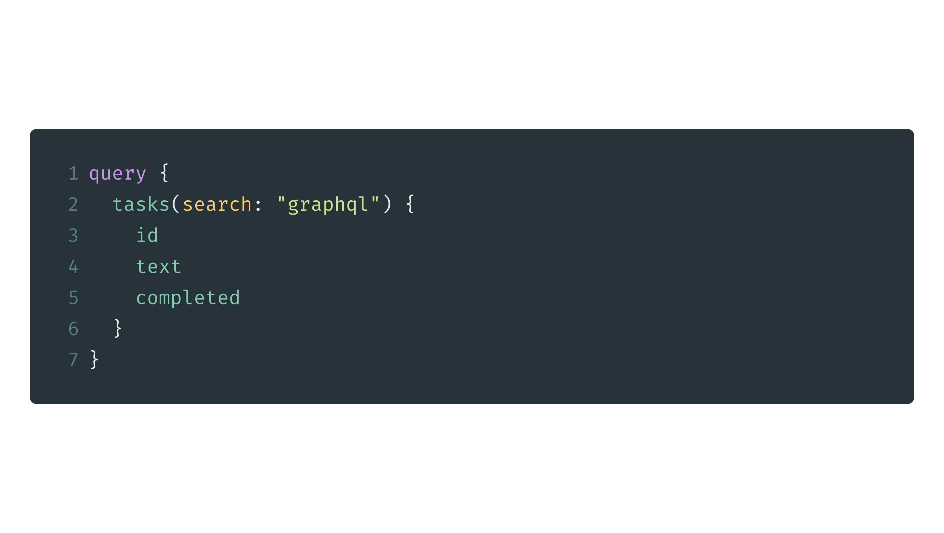
Query & Mutation
Query
Arguments
Mutation
Operation Name
Fragment
Alias
Variable
Directive

Slide 30
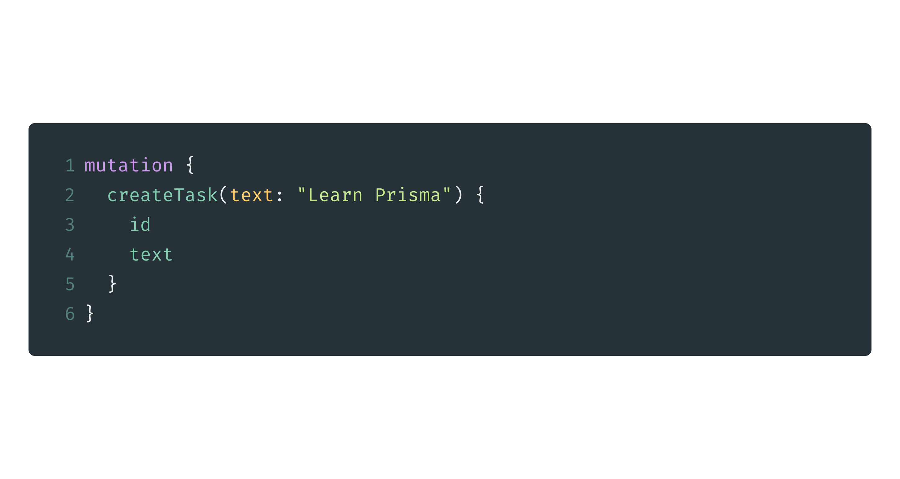
Query & Mutation
Query
Arguments
Mutation
Operation Name
Fragment
Alias
Variable
Directive

Slide 31
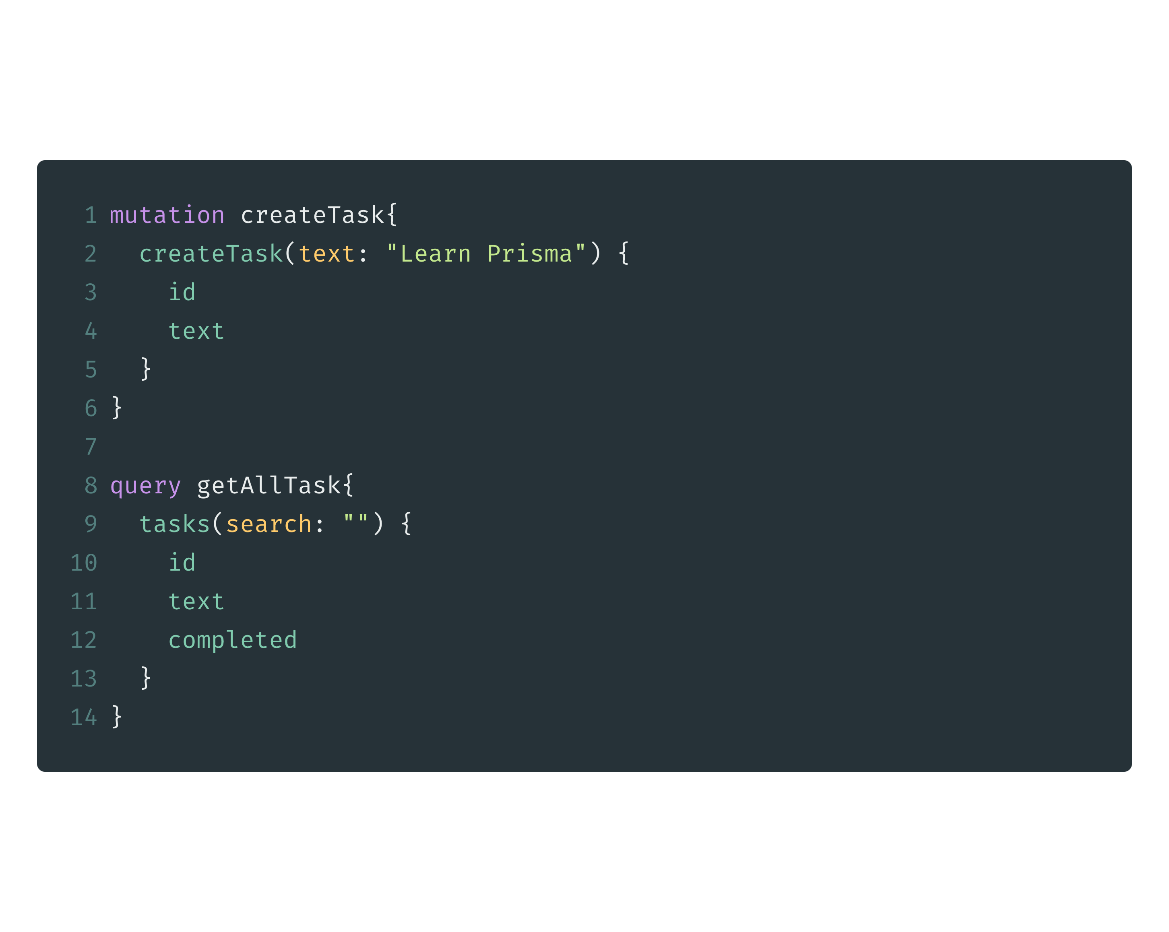
Query & Mutation
Query
Arguments
Mutation
Operation Name
Fragment
Alias
Variable
Directive

Slide 32
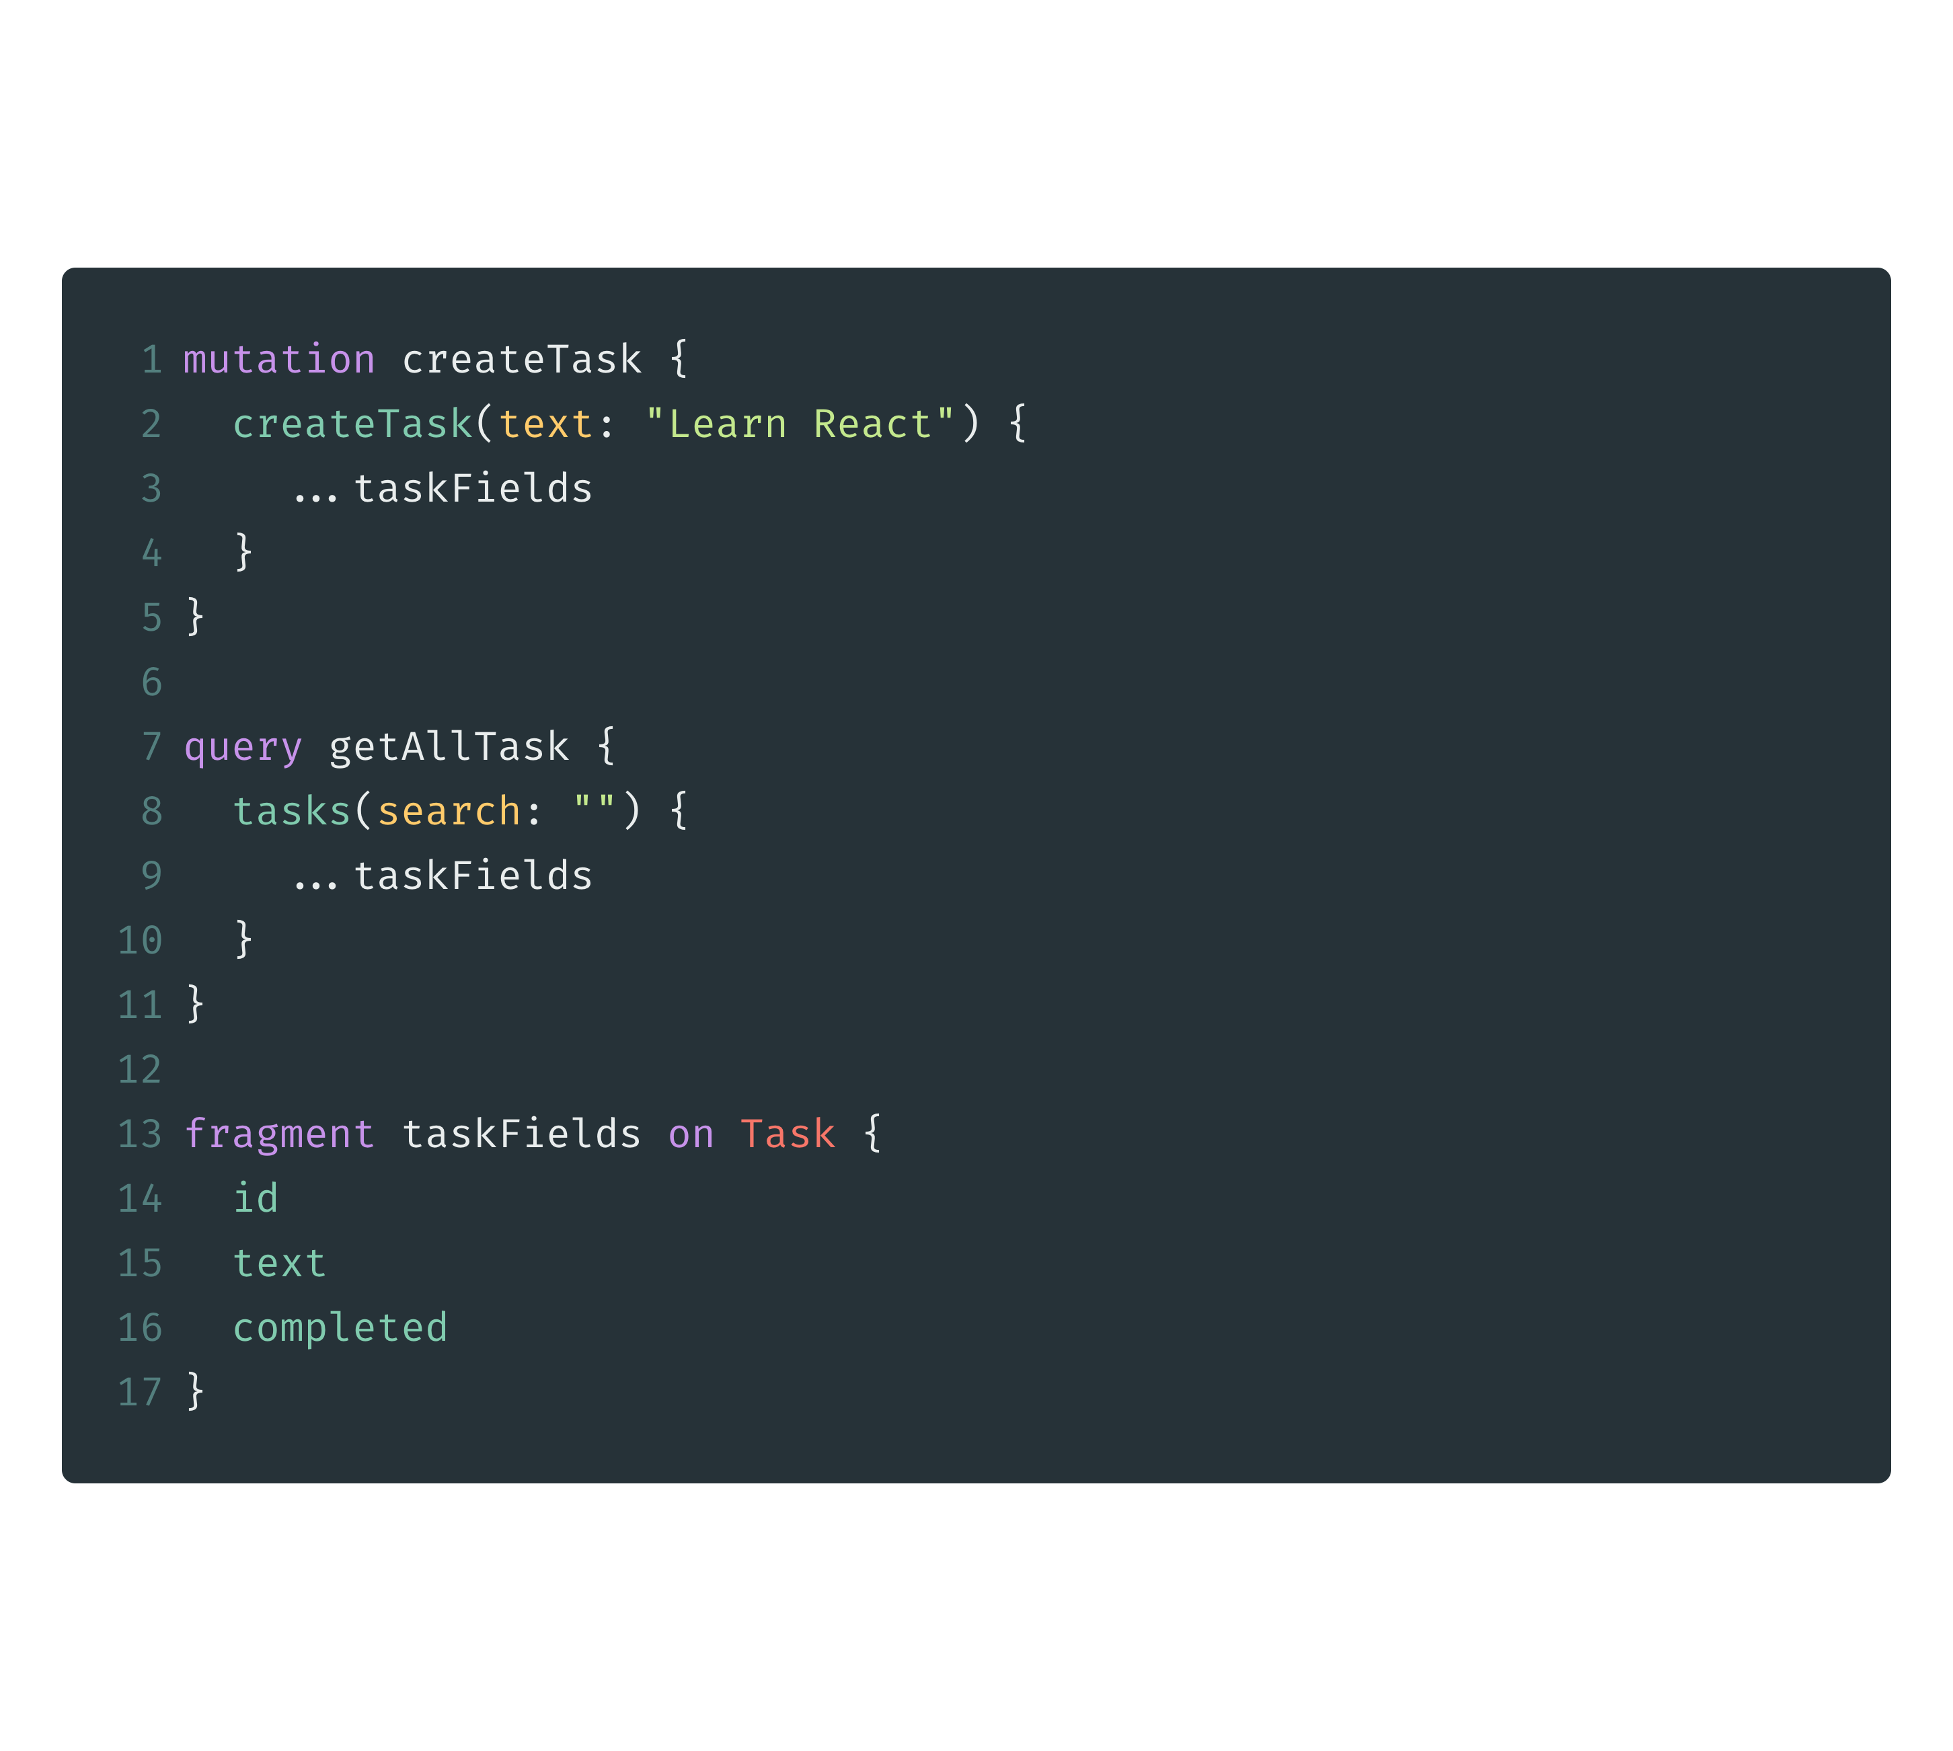
Query & Mutation
Query
Arguments
Mutation
Operation Name
Fragment
Alias
Variable
Directive

Slide 33
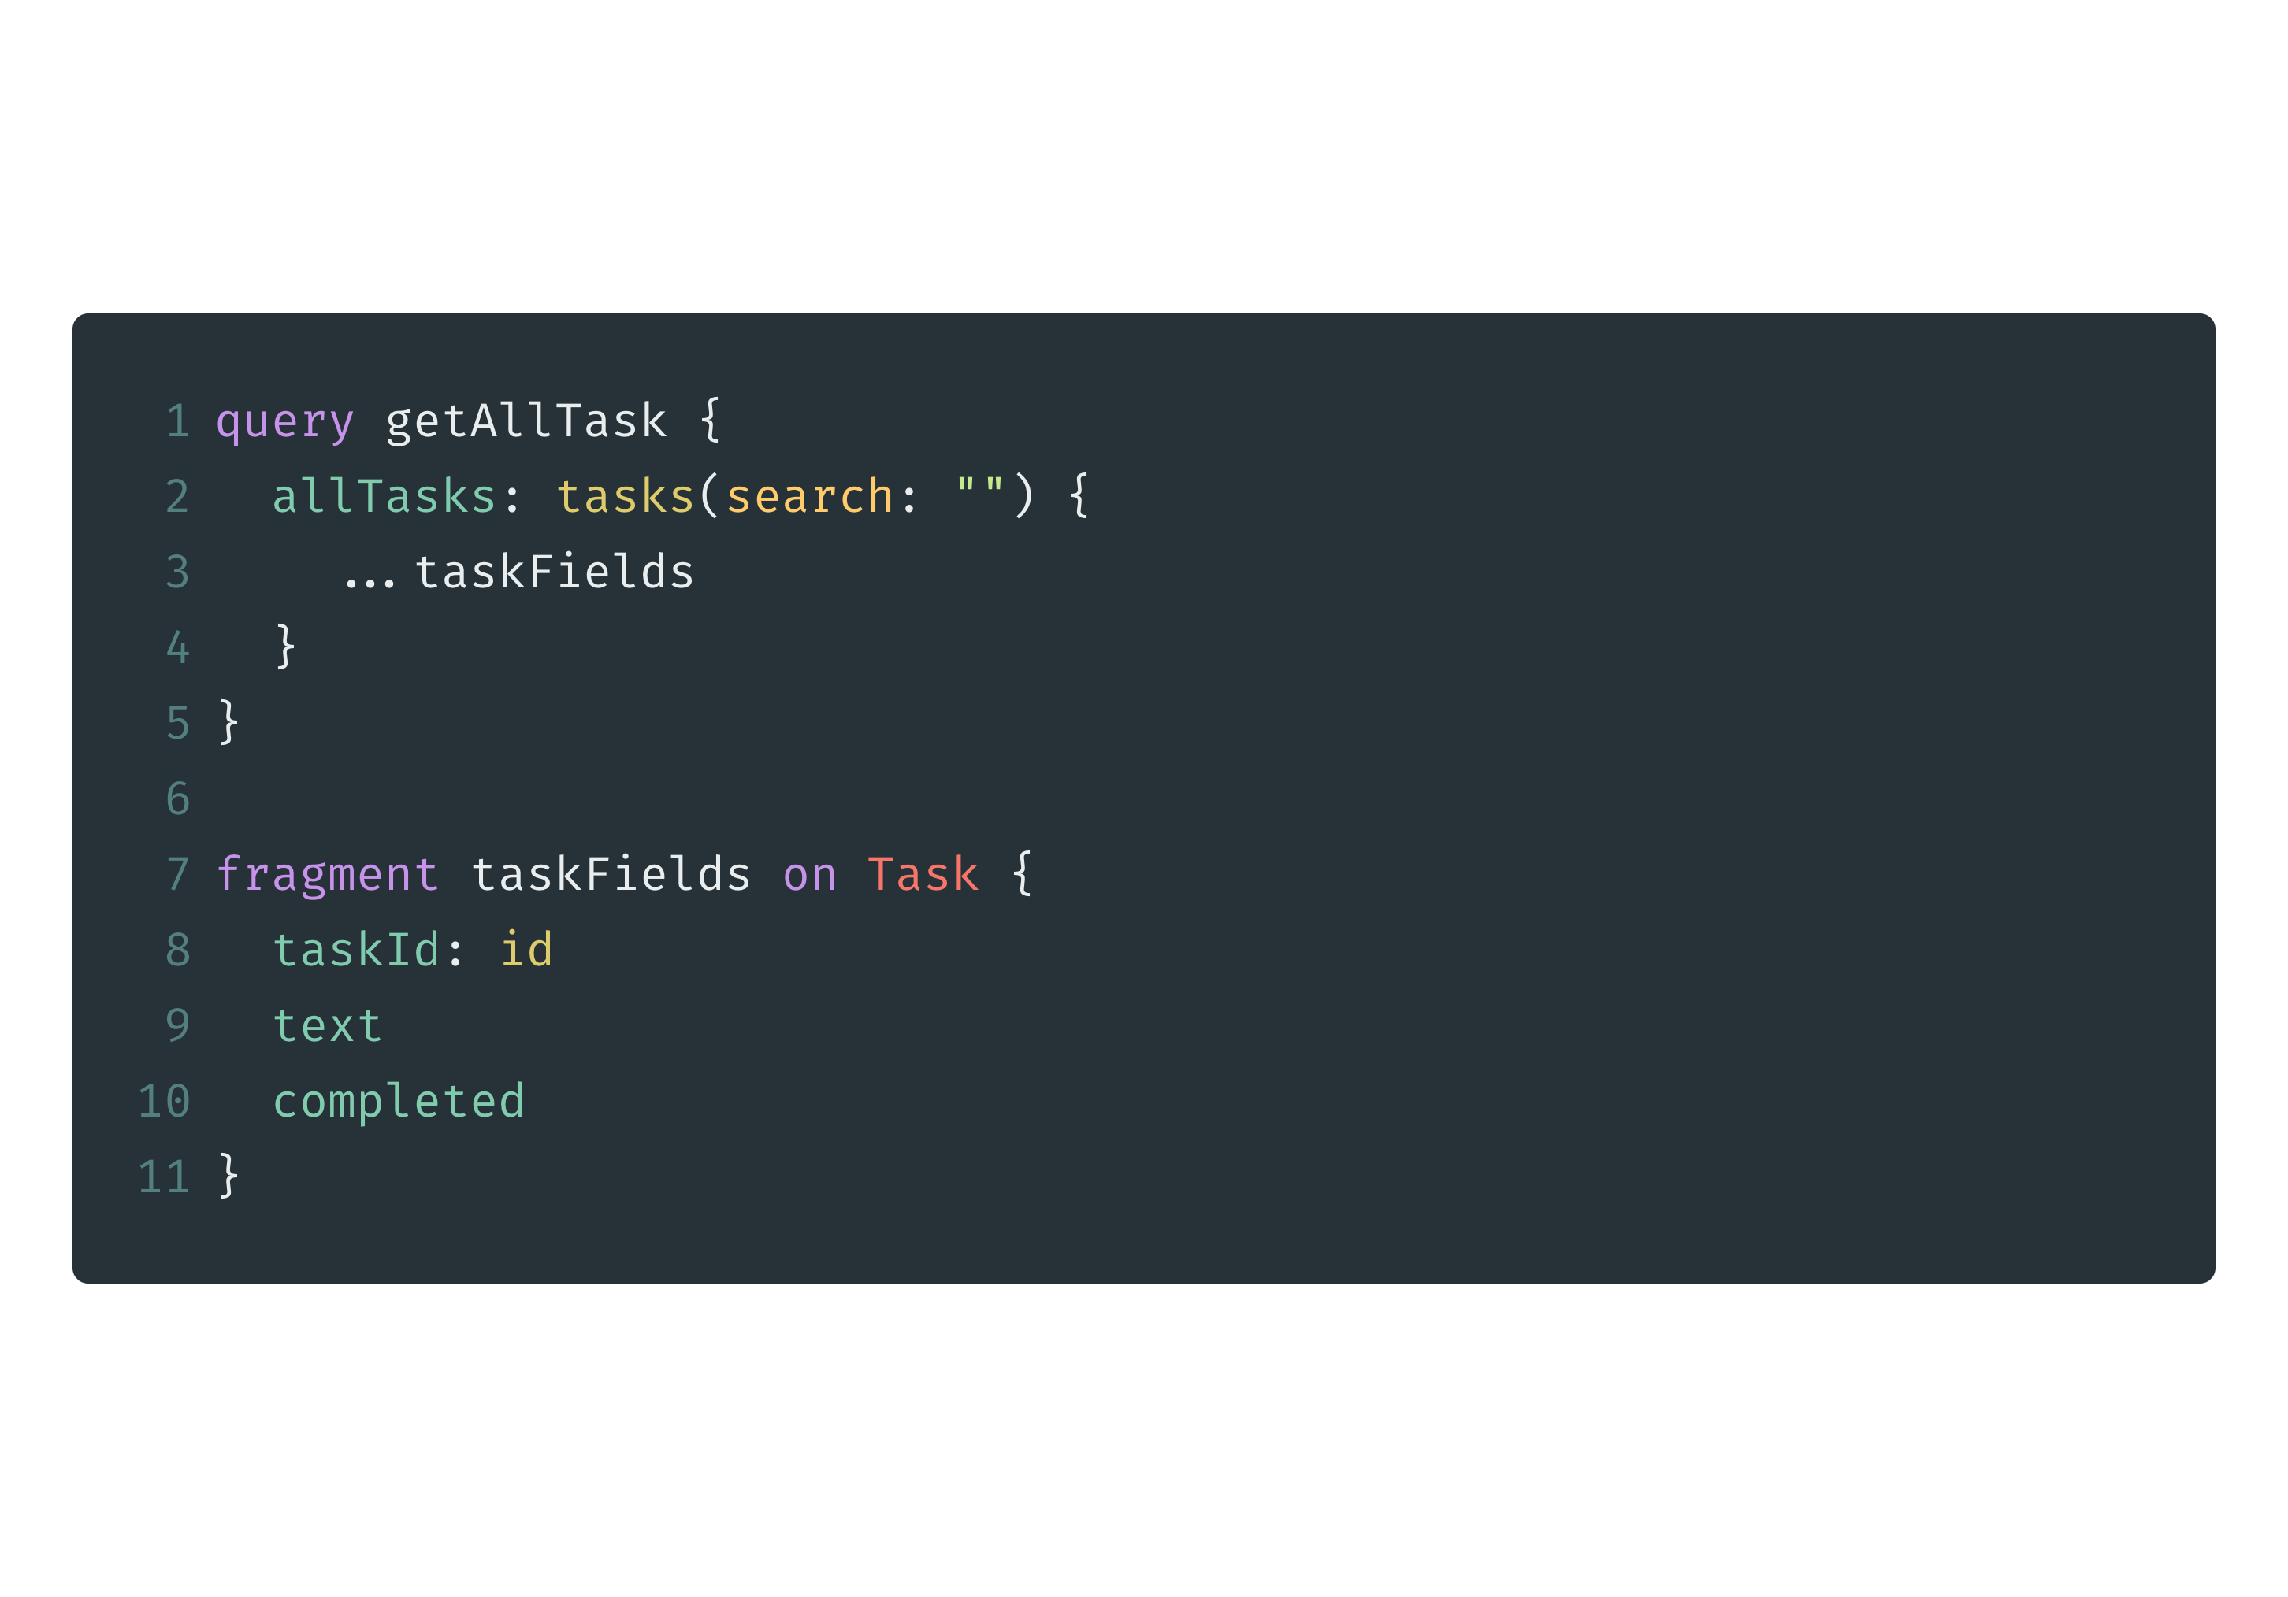
Query & Mutation
Query
Arguments
Mutation
Operation Name
Fragment
Alias
Variable
Directive

Slide 34
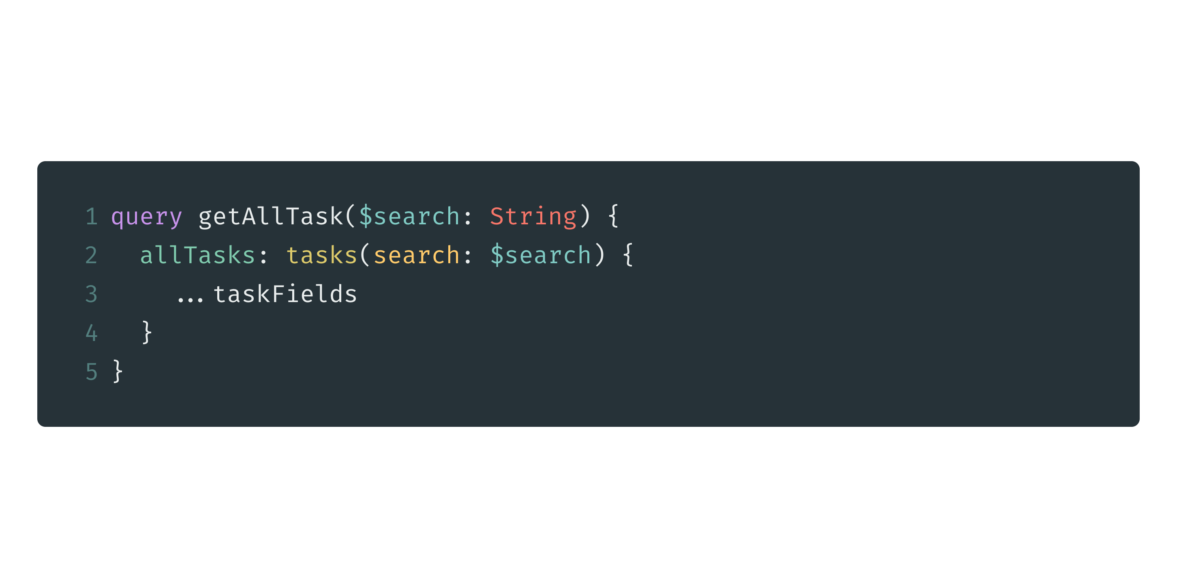
Query & Mutation
Query
Arguments
Mutation
Operation Name
Fragment
Alias
Variable
Directive

Slide 35
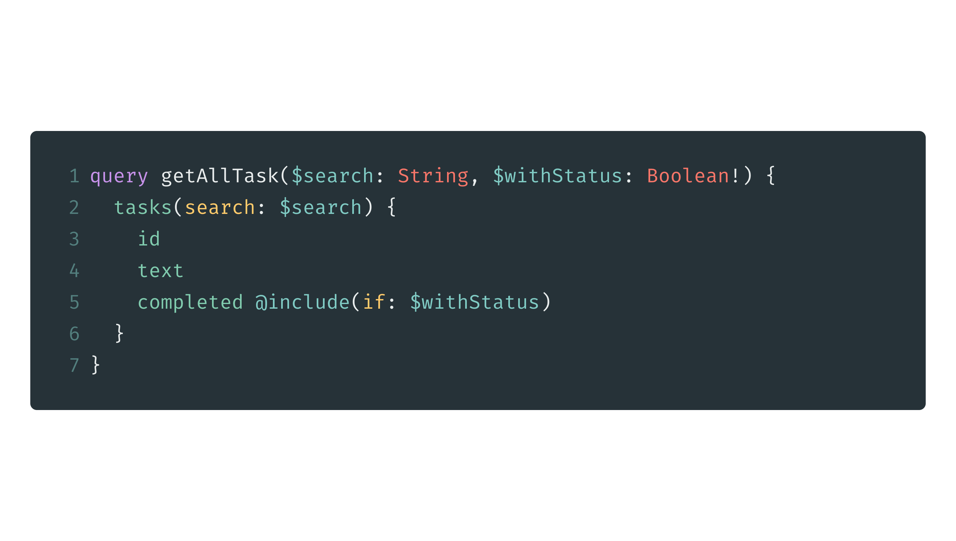
Query & Mutation
Query
Arguments
Mutation
Operation Name
Fragment
Alias
Variable
Directive

Slide 36

Data Access Layer with Prisma

Slide 37
What is Prisma?
DB-agnostic data access layer (think ORM)
Prisma server & Prisma client
Declarative data modelling & migrations

Slide 38
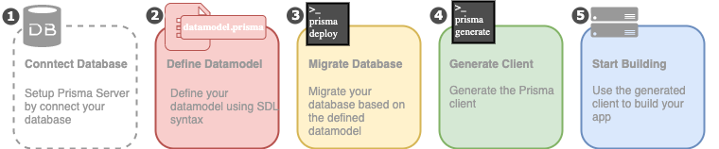
How Prisma Works

Slide 39
3-Main Concept
1. Datamodel
2. Prisma Server
3. Prisma Client

Slide 40
1. Datamodel
Defines the models of your application and is foundation for the Prisma client API.
The datamodel is written in .prisma-files and uses GraphQL SDL syntax.
Using the datamodel for database migrations (optional)

Slide 41
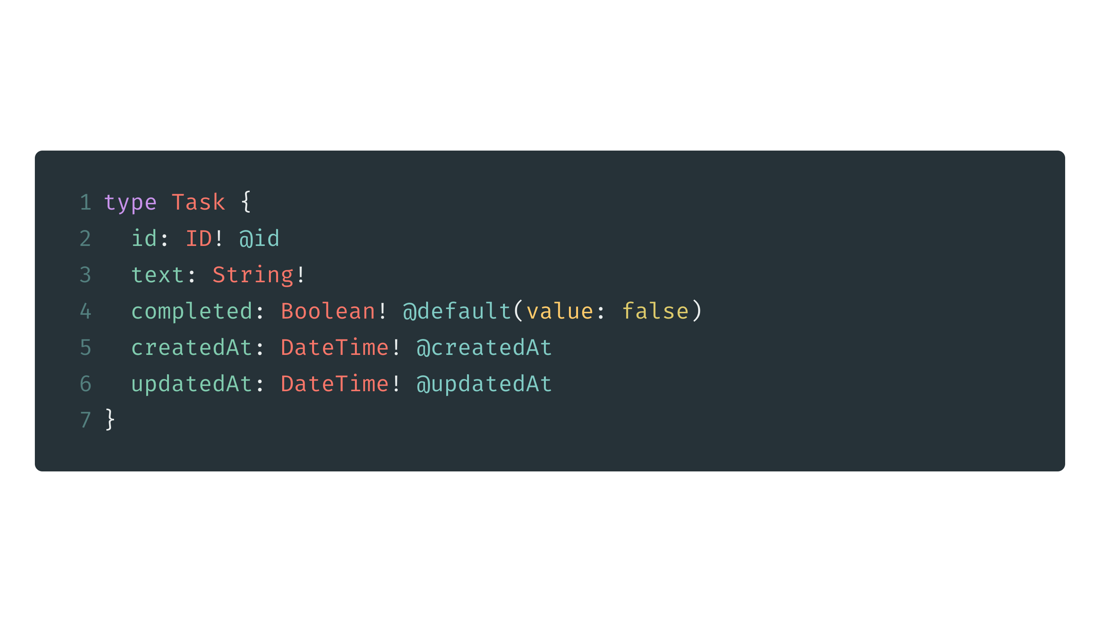
Example Datamodel

Slide 42
2. Prisma Server
The Prisma server is a standalone infrastructure component that is connected to your database
Prisma servers can be run with Docker
Prisma Services

Slide 43
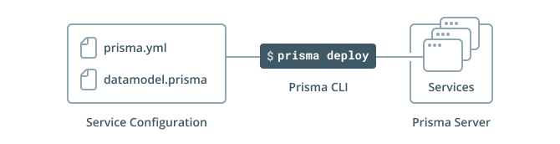
2. Prisma Server

Slide 44
Minimal prisma.yml
endpoint: http://localhost:4466
datamodel: datamodel.prisma

Slide 45
3. Prisma Client
The Prisma client is an auto-generated library that replaces a traditional ORM in your API
It connects to a Prisma server which sits on top your database
Use prisma generate to create client

Slide 46
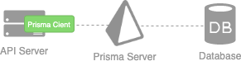
3. Prisma Client

Slide 47
Update prisma.yml
endpoint: http://localhost:4466
datamodel: datamodel.prisma
generate:
- generator: javascript-client
output: ./generated/prisma-client/
hooks:
post-deploy:
- prisma generate

Slide 48
Play with Prisma Client
cd prisma
npm init -y
npm install prisma-client-lib
touch playground.js
code .

Slide 49
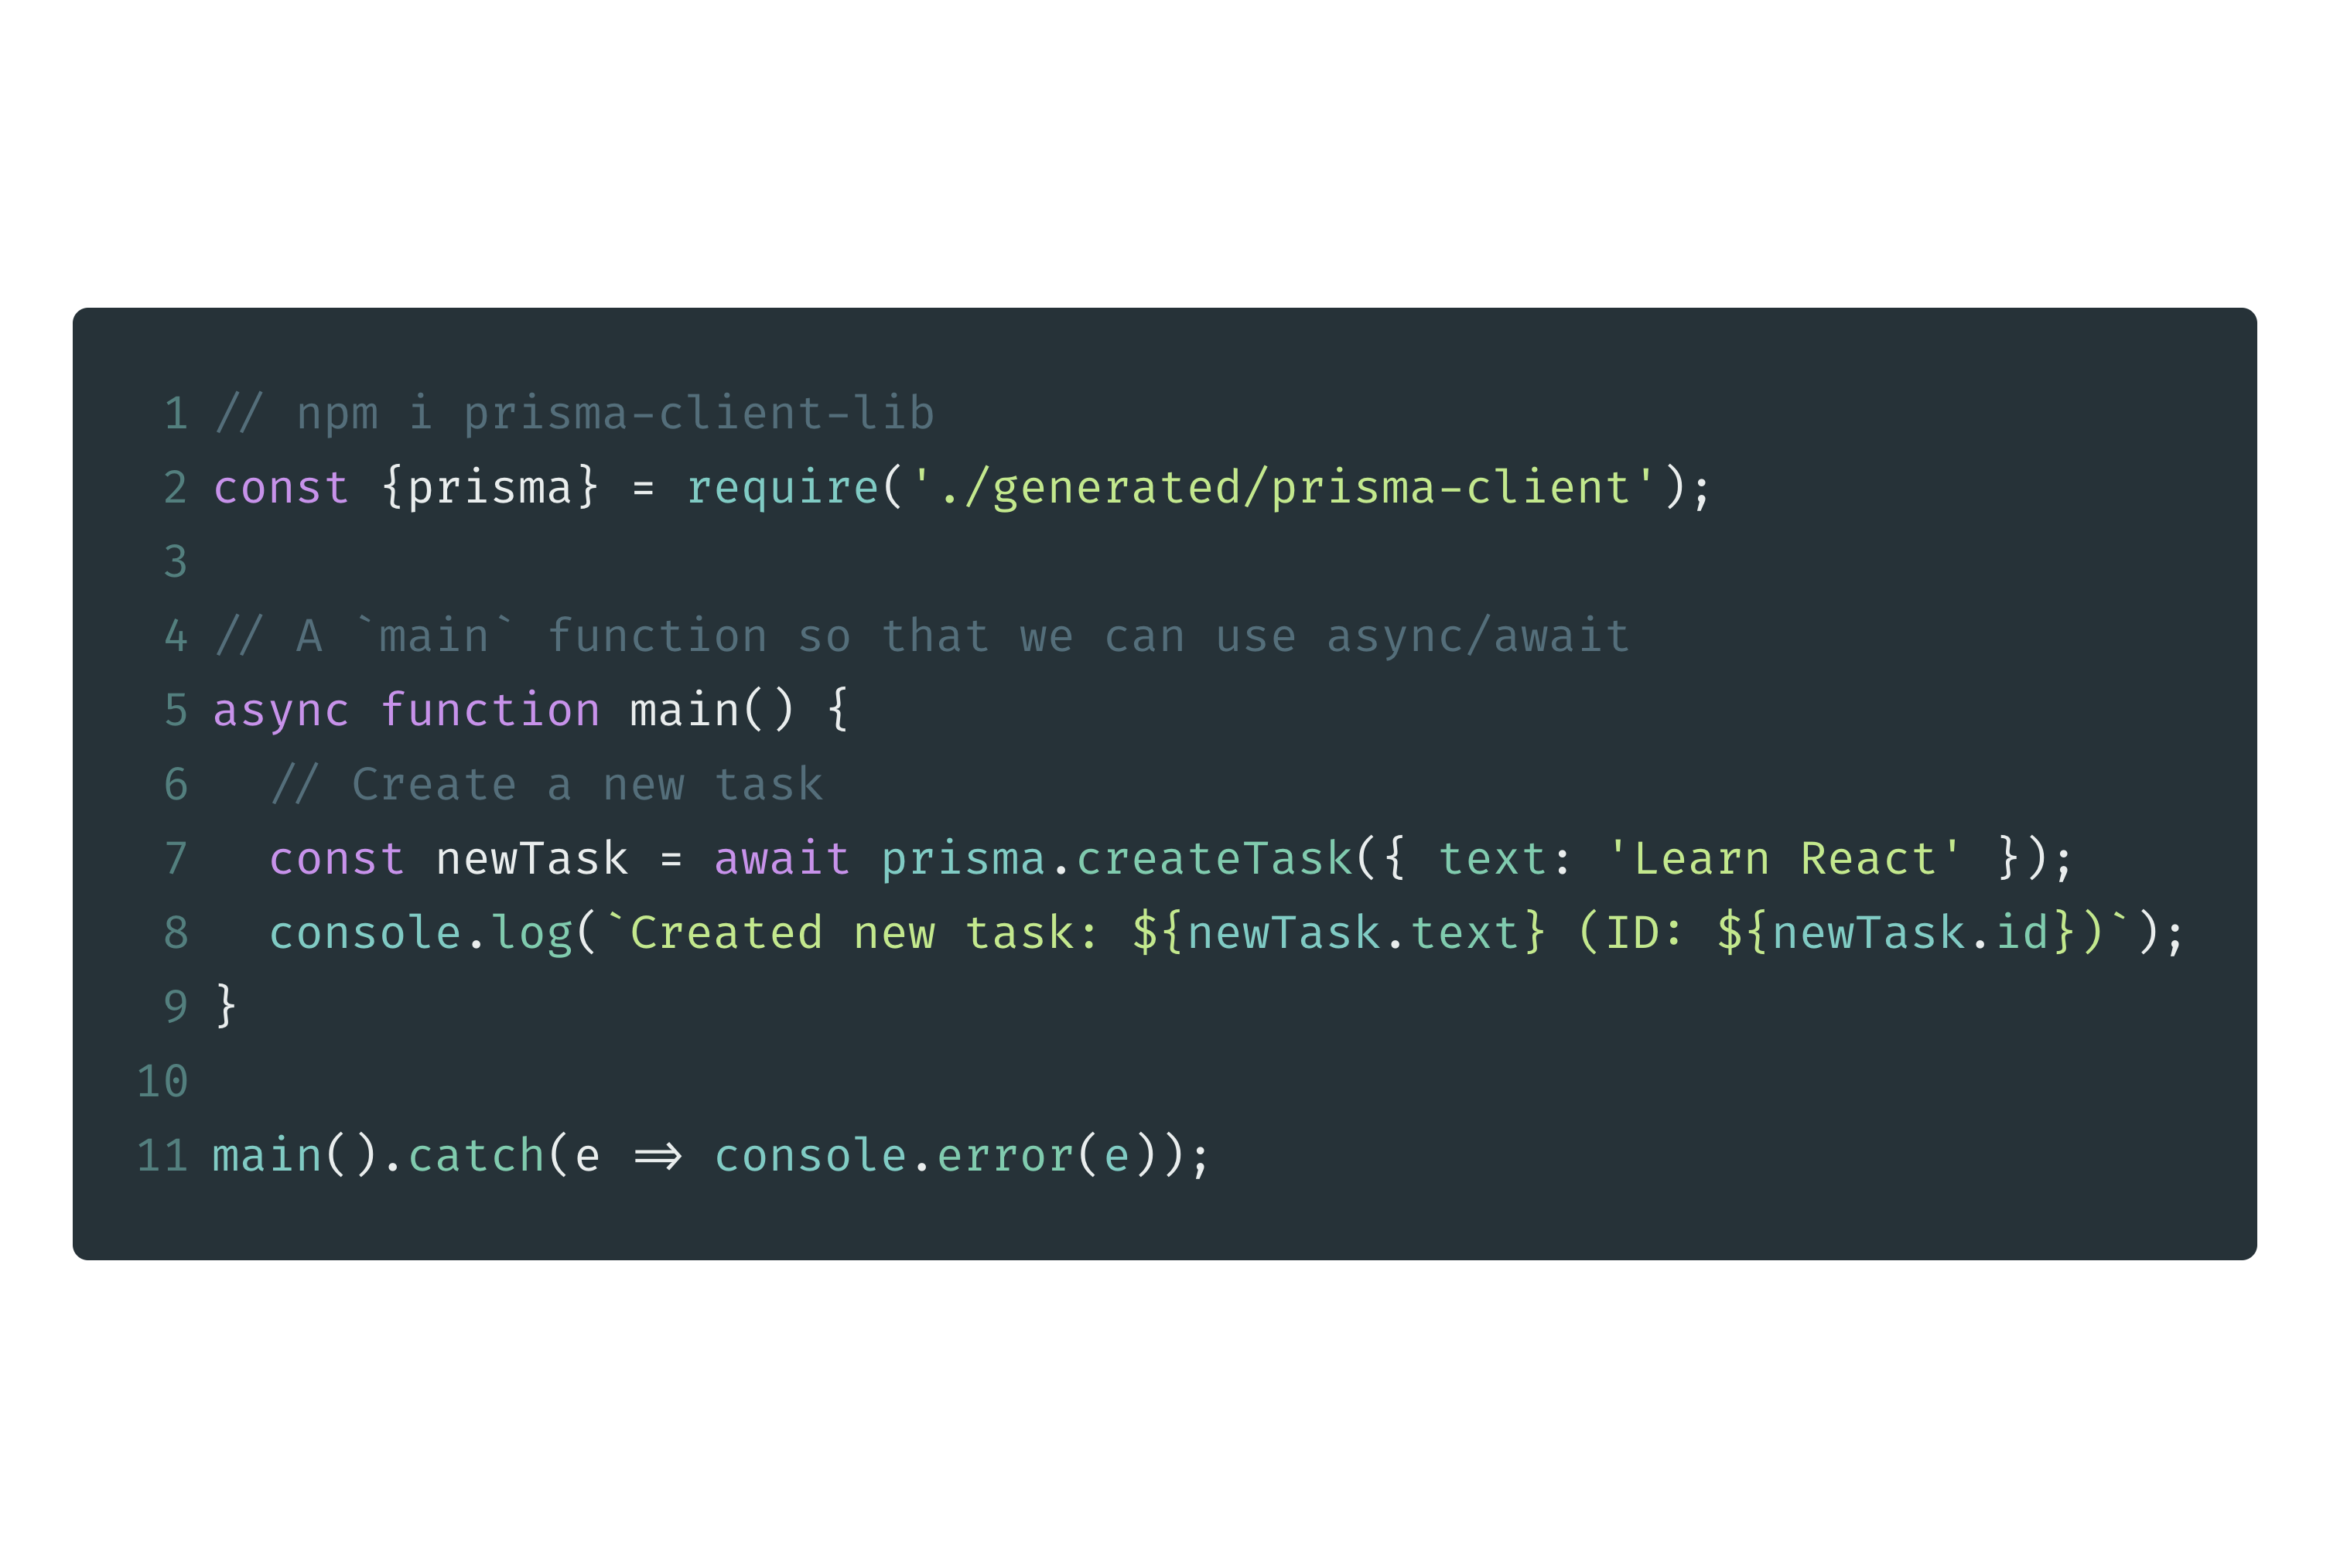
Create

Slide 50
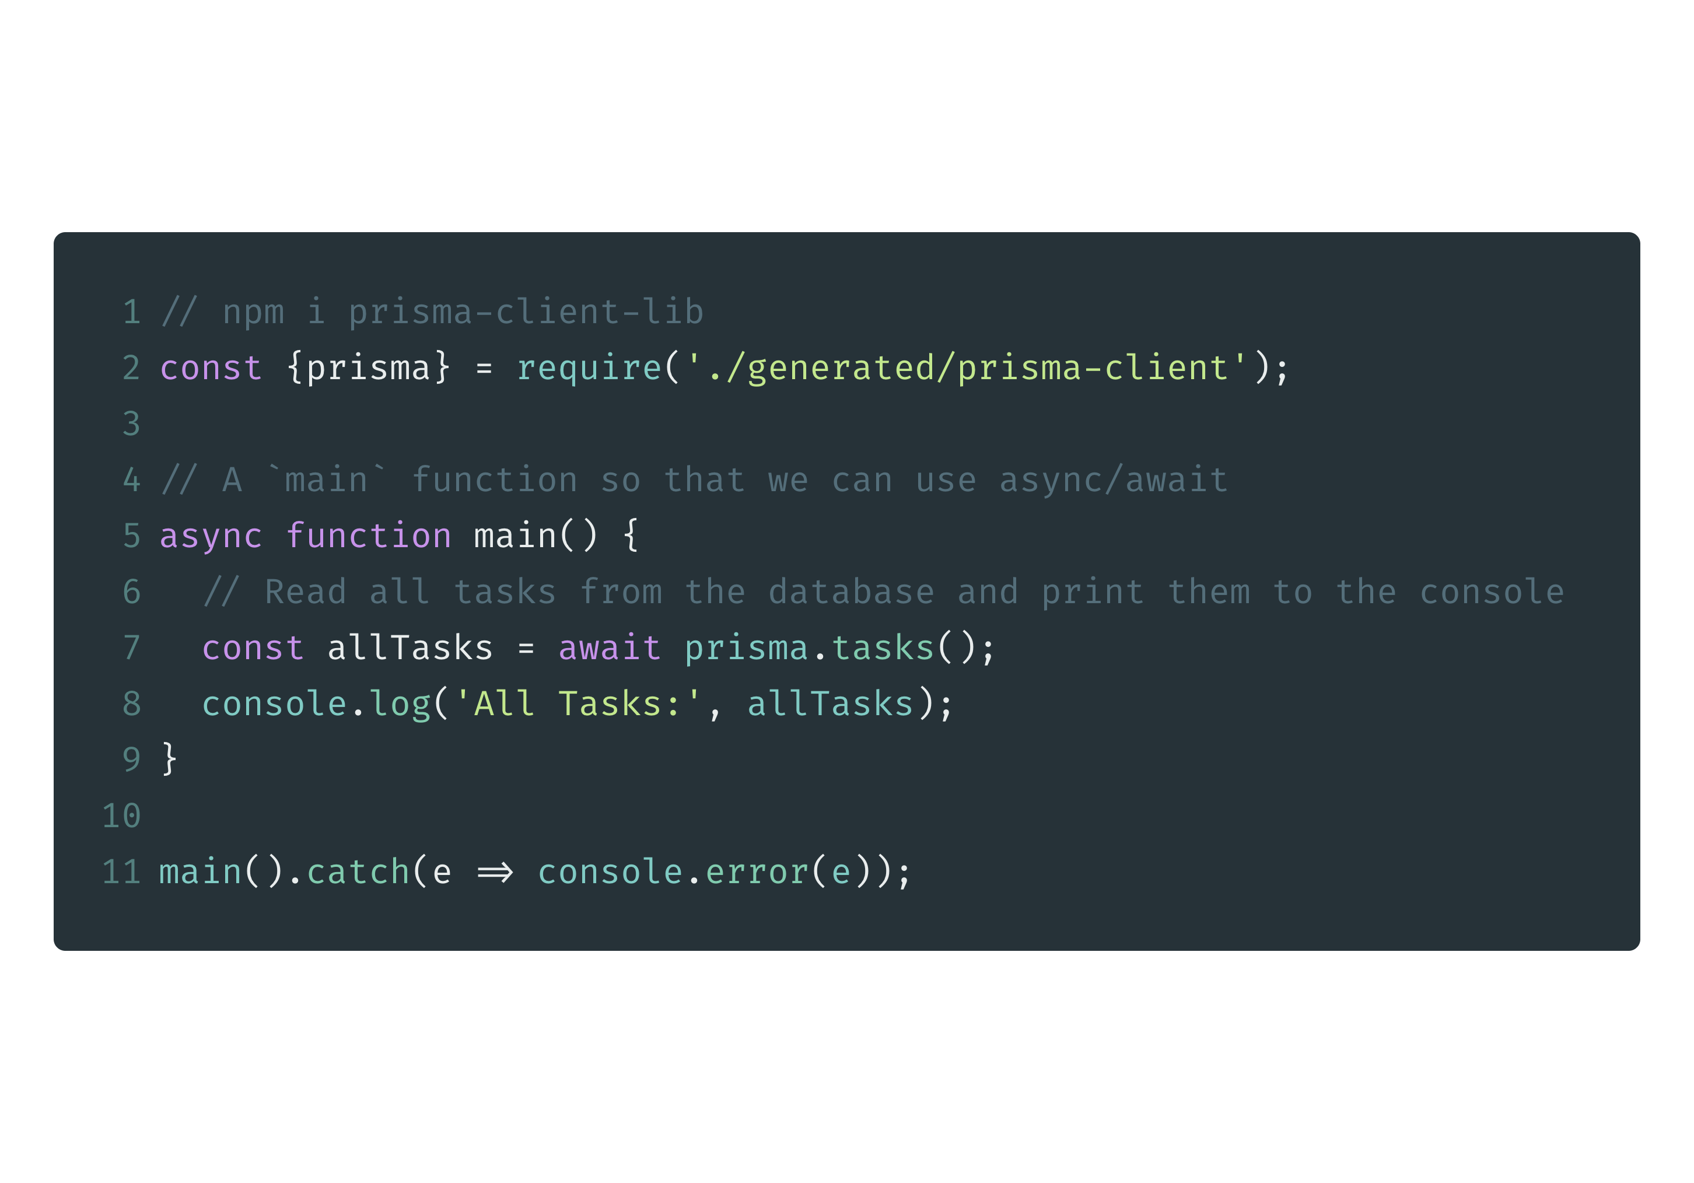
Read (All)

Slide 51
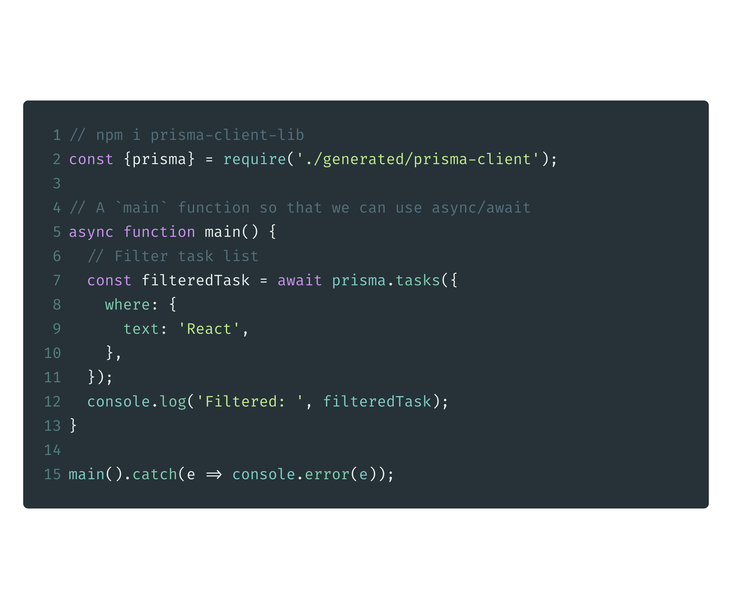
Read (All with Fliter)

Slide 52
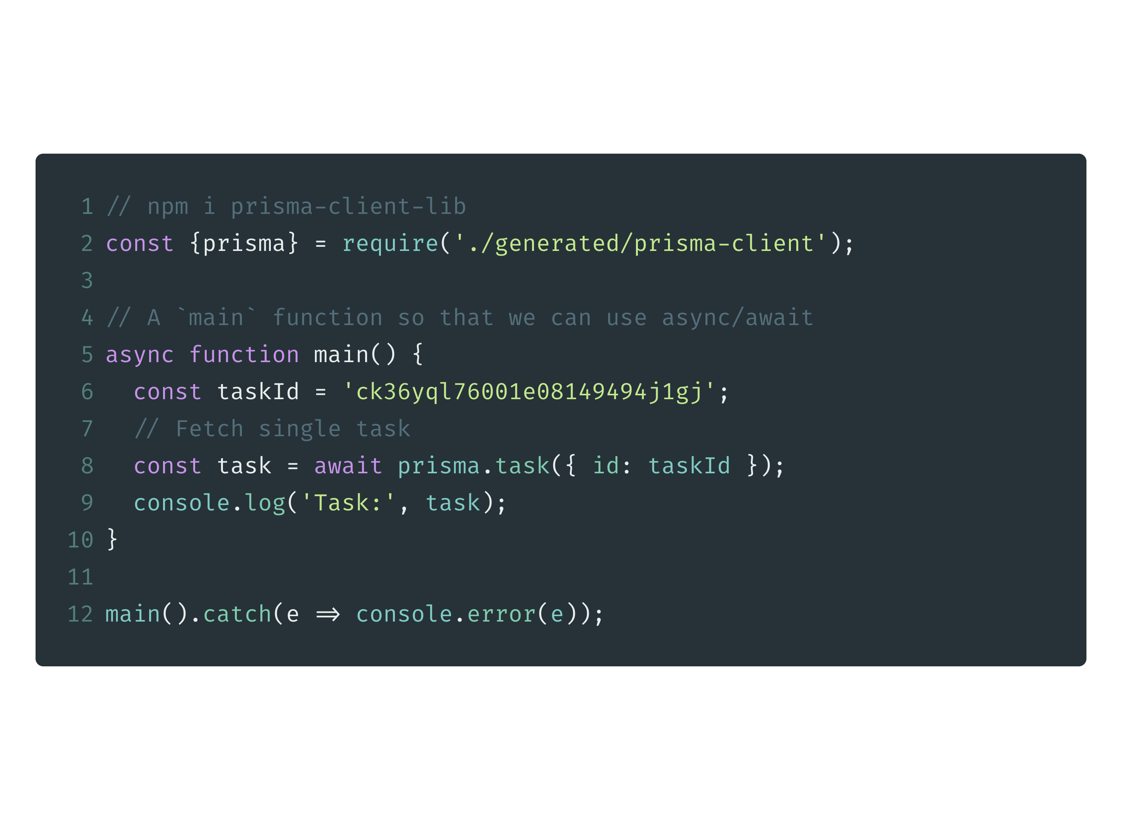
Read (Single)

Slide 53
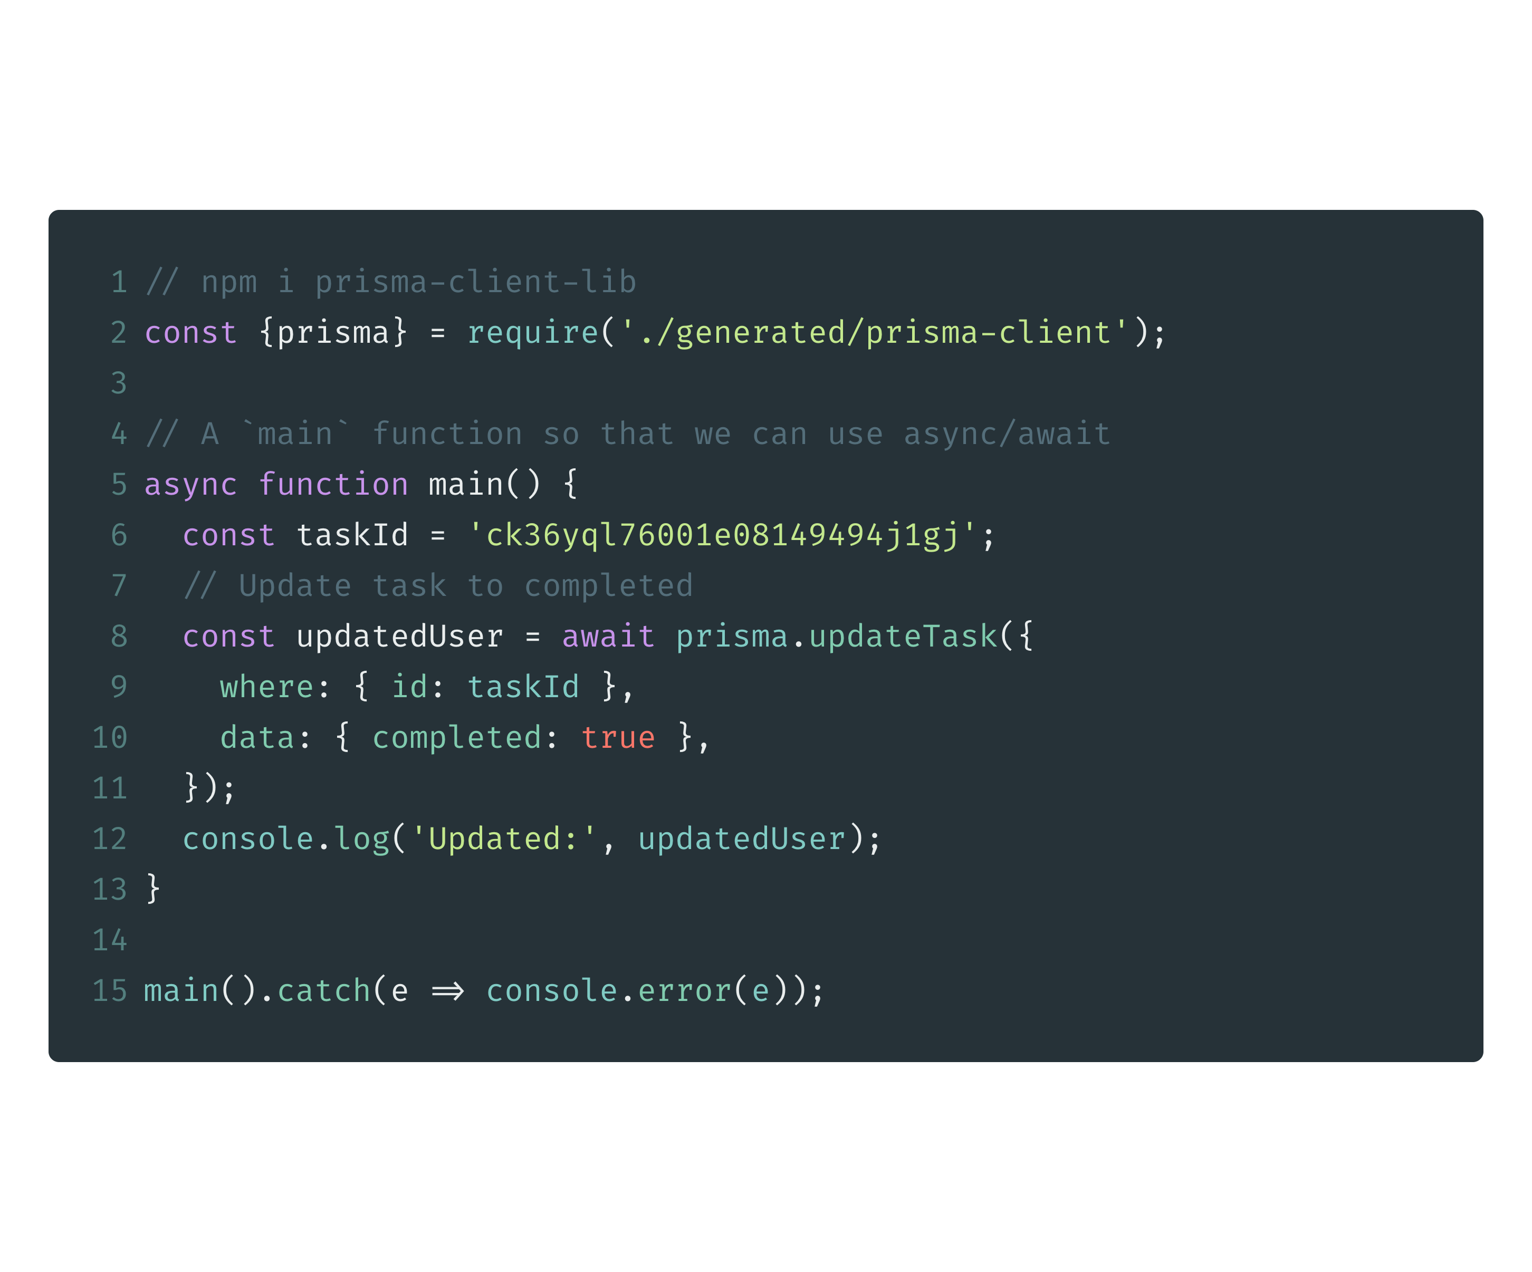
Update

Slide 54
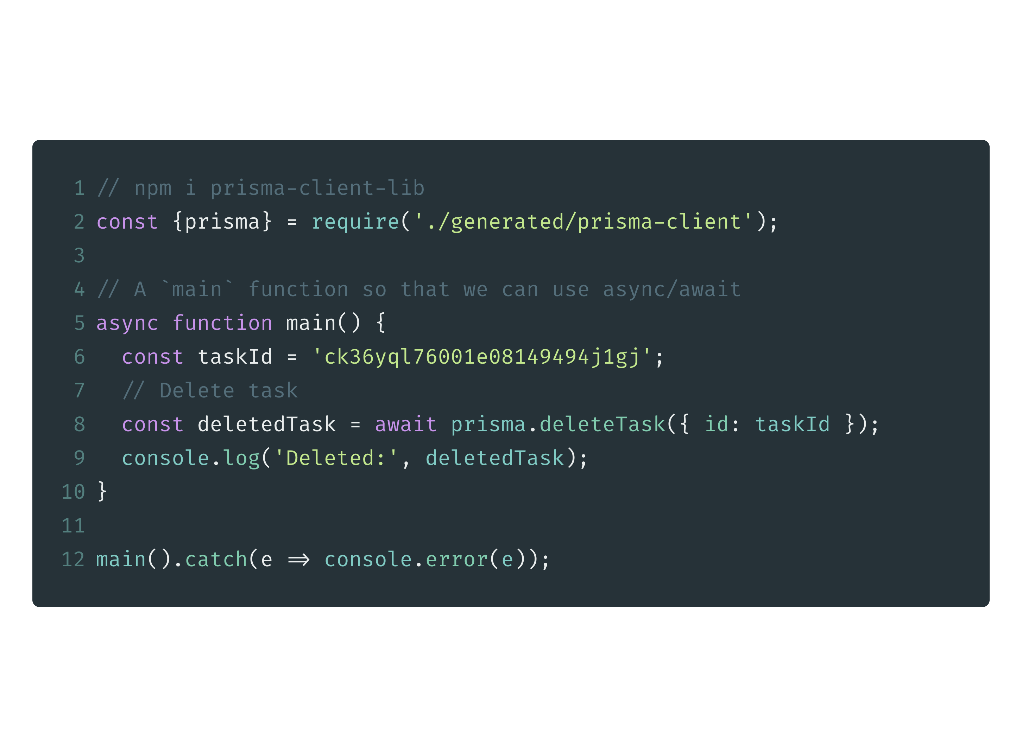
Delete

Slide 55
Add Prisma to GraphQL Server
# change output path to gql-server/src in prisma.yml
prisma generate
cd ../gql-server
npm install prisma-client-lib
code .

Slide 56
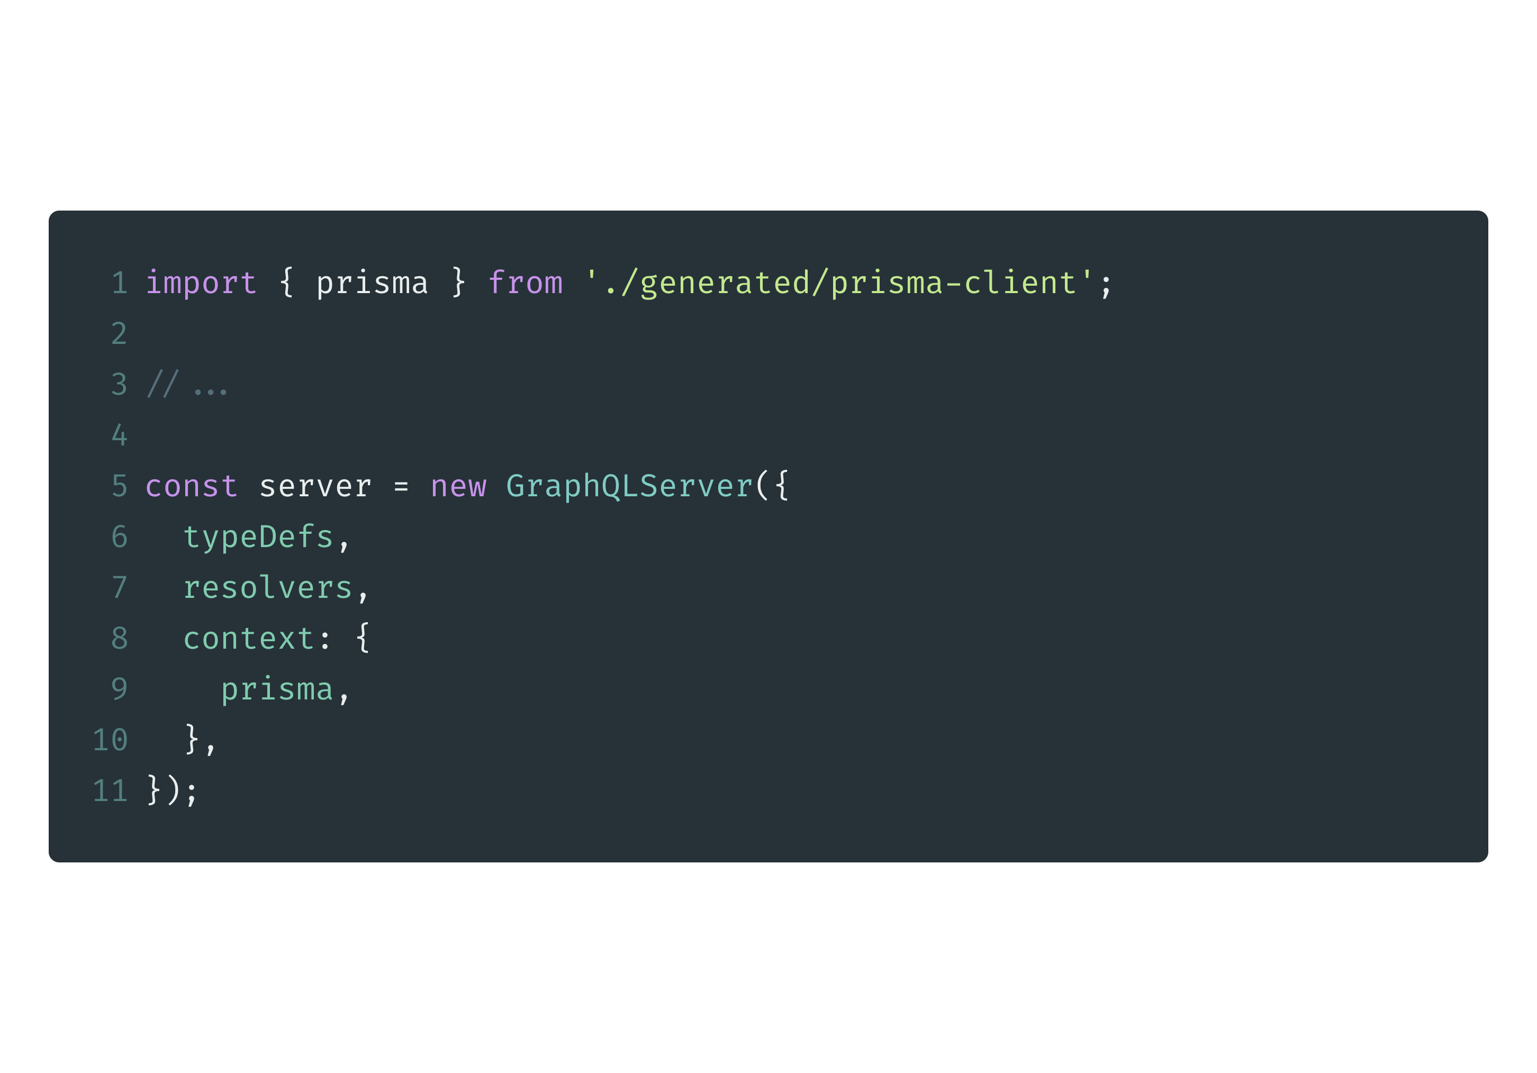
Add database layer with prisma

Slide 57
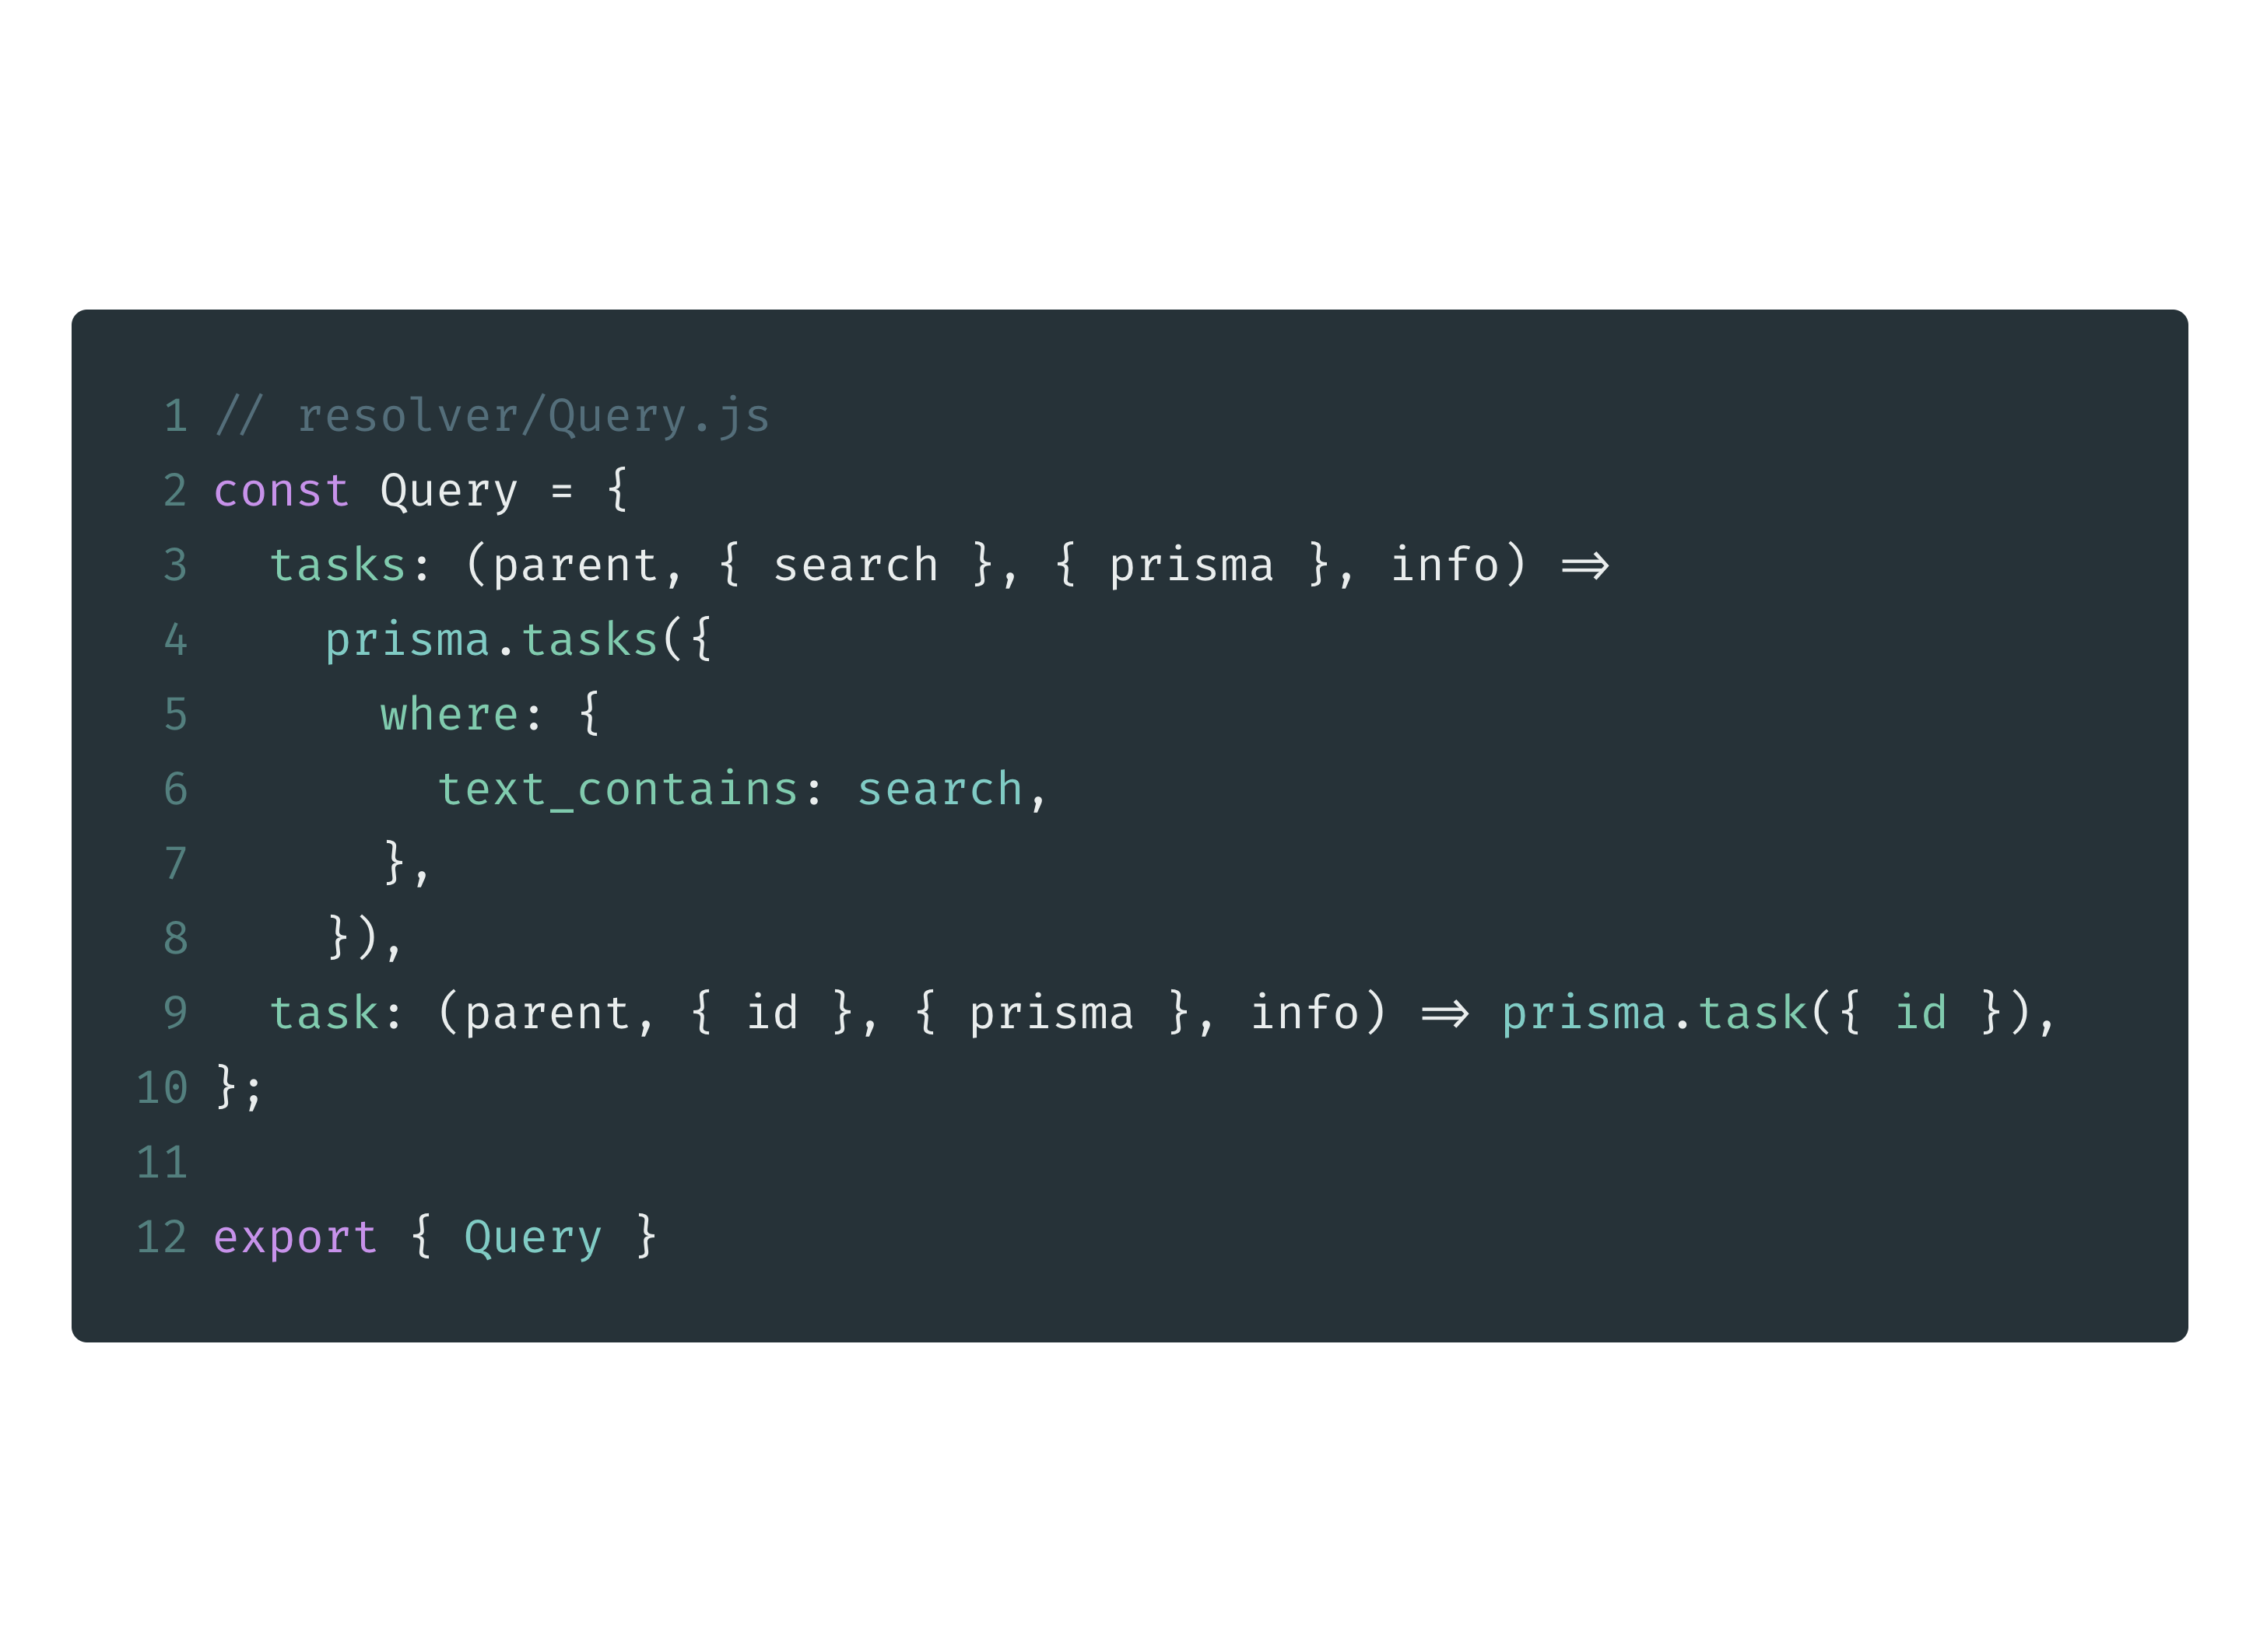
Complete API operations against the database

Slide 58
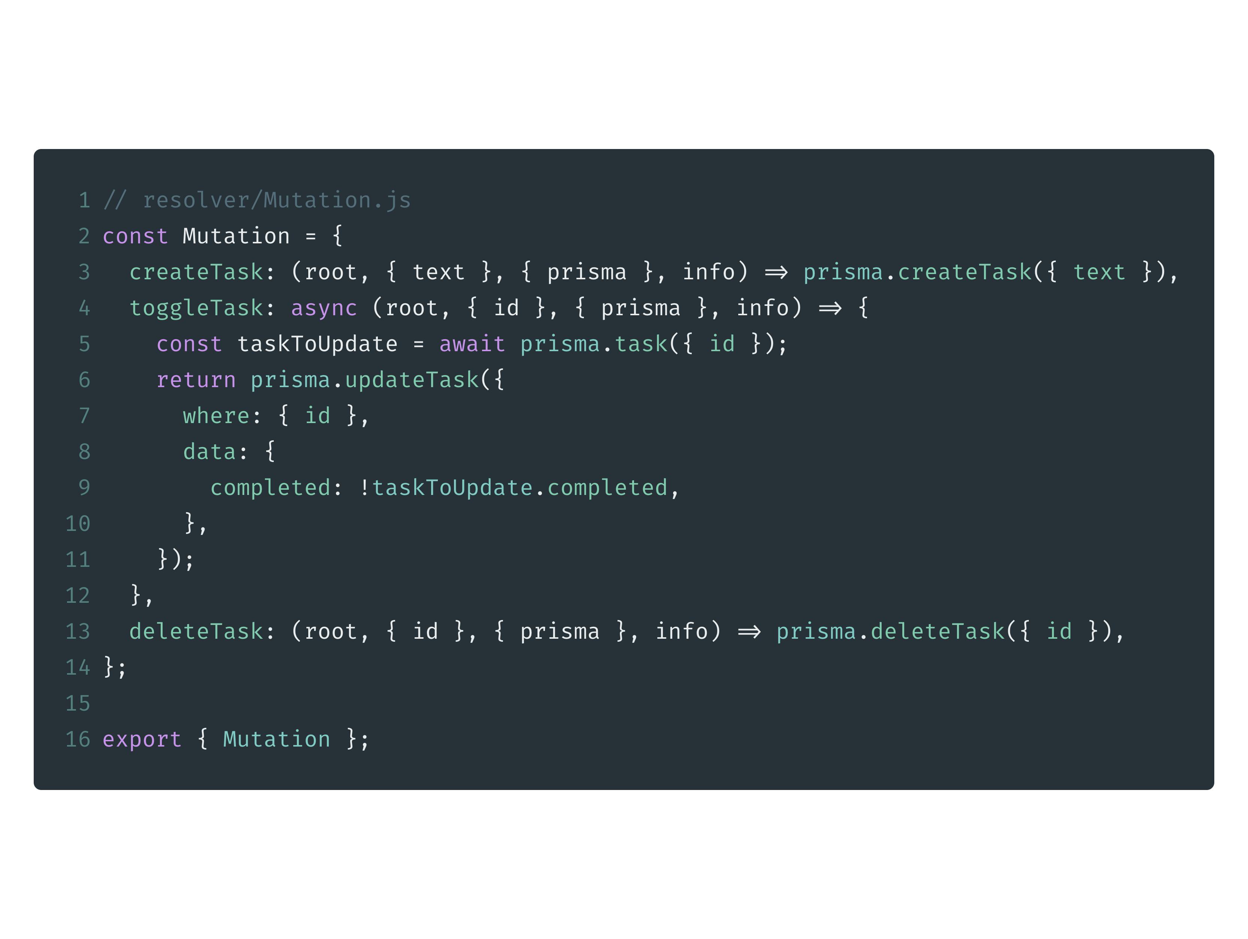
Complete API operations against the database

Slide 59
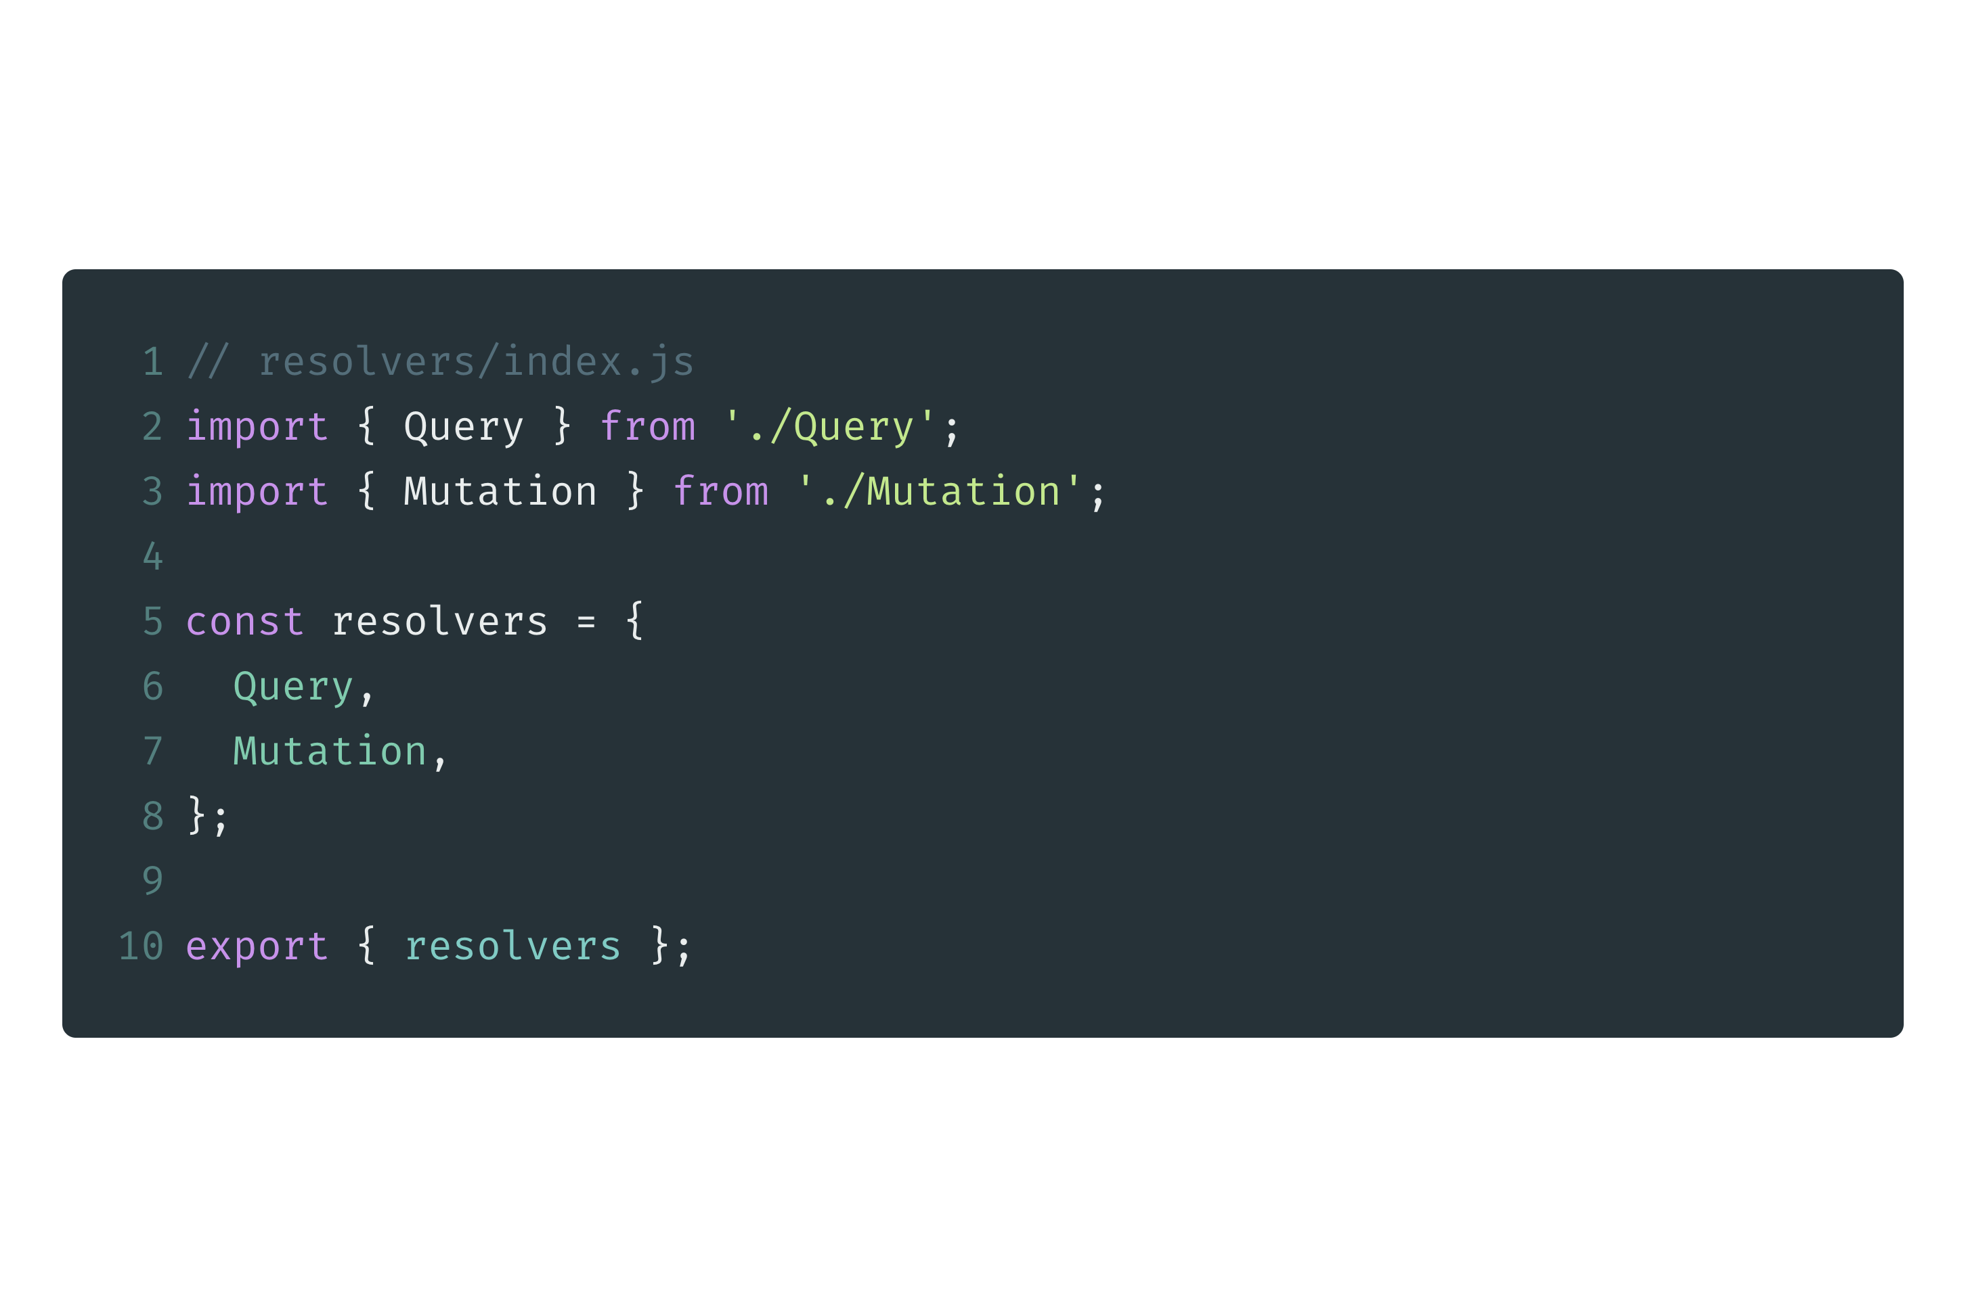
Complete API operations against the database

Slide 60
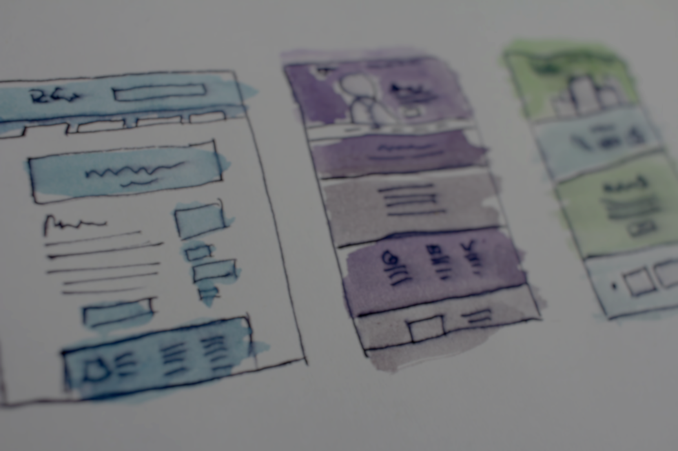
React & Apollo Boost

Slide 61
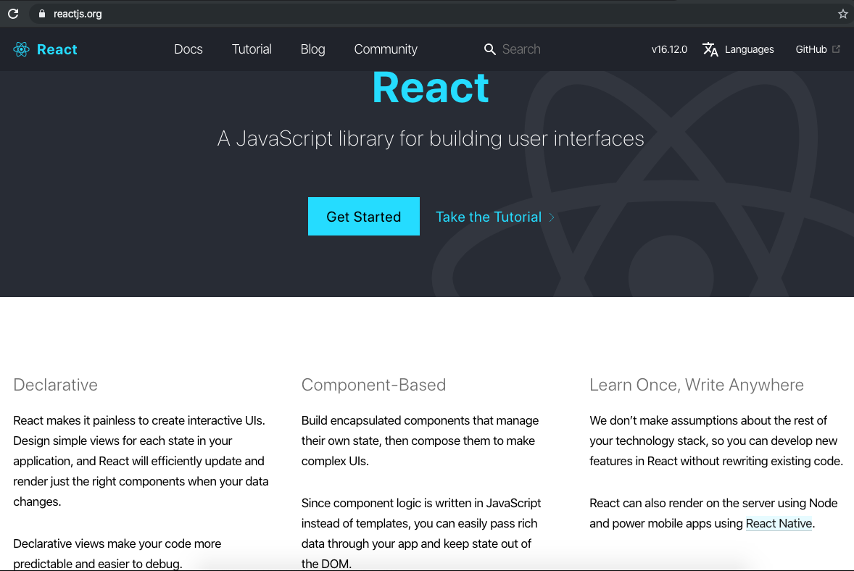

Slide 62
Create React App
npx create-react-app client
cd client
npm start

Slide 63
Workshop: React Basic
JSX
Use Semantic UI
Component & Props
State & Events Handler
Form
Life Cycle
HTTP Request
https://github.com/somprasongd/todo-react-app

Slide 64
Apollo Client
Apollo Client is a complete state management library for JavaScript apps
Simply write a GraphQL query
Apollo Client will take care of requesting and caching your data, as well as updating your UI
https://www.apollographql.com/docs/react/

Slide 65
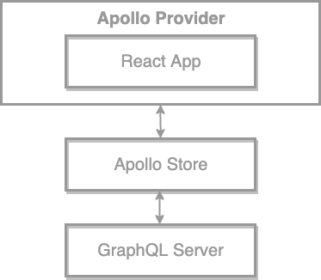
How Apollo Client Works

Slide 66
Setup Apollo Client
npm install apollo-boost @apollo/react-hooks graphql
# apollo-boost: Package containing everything you need to set up Apollo Client
# @apollo/react-hooks: React hooks based view layer integration
# graphql: Also parses your GraphQL queries

Slide 67
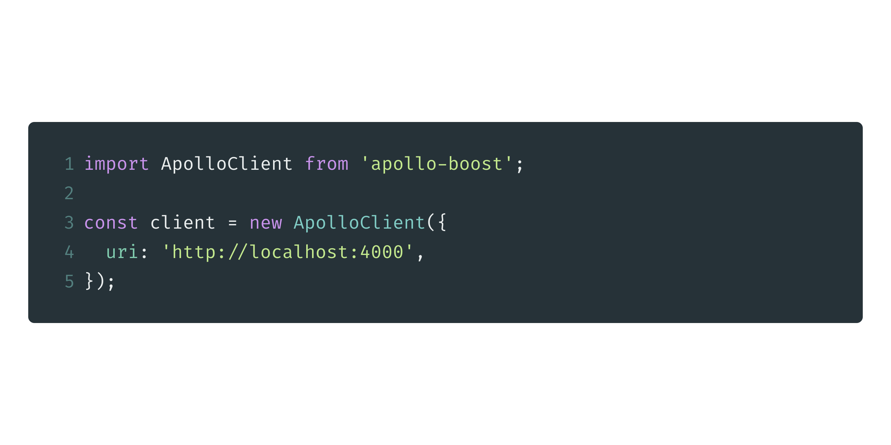
Create Apollo Client

Slide 68
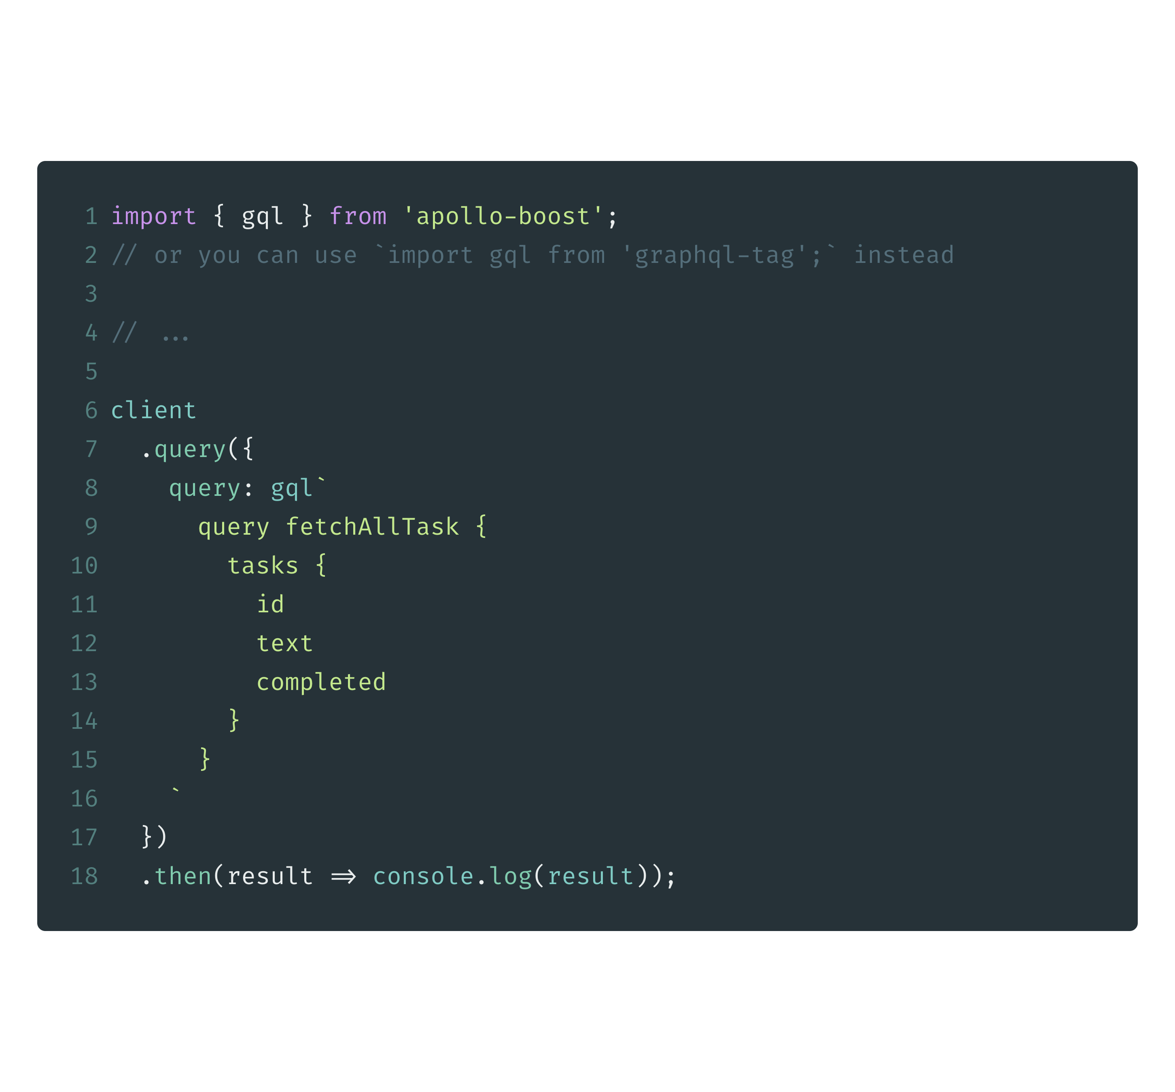
Make your first query

Slide 69
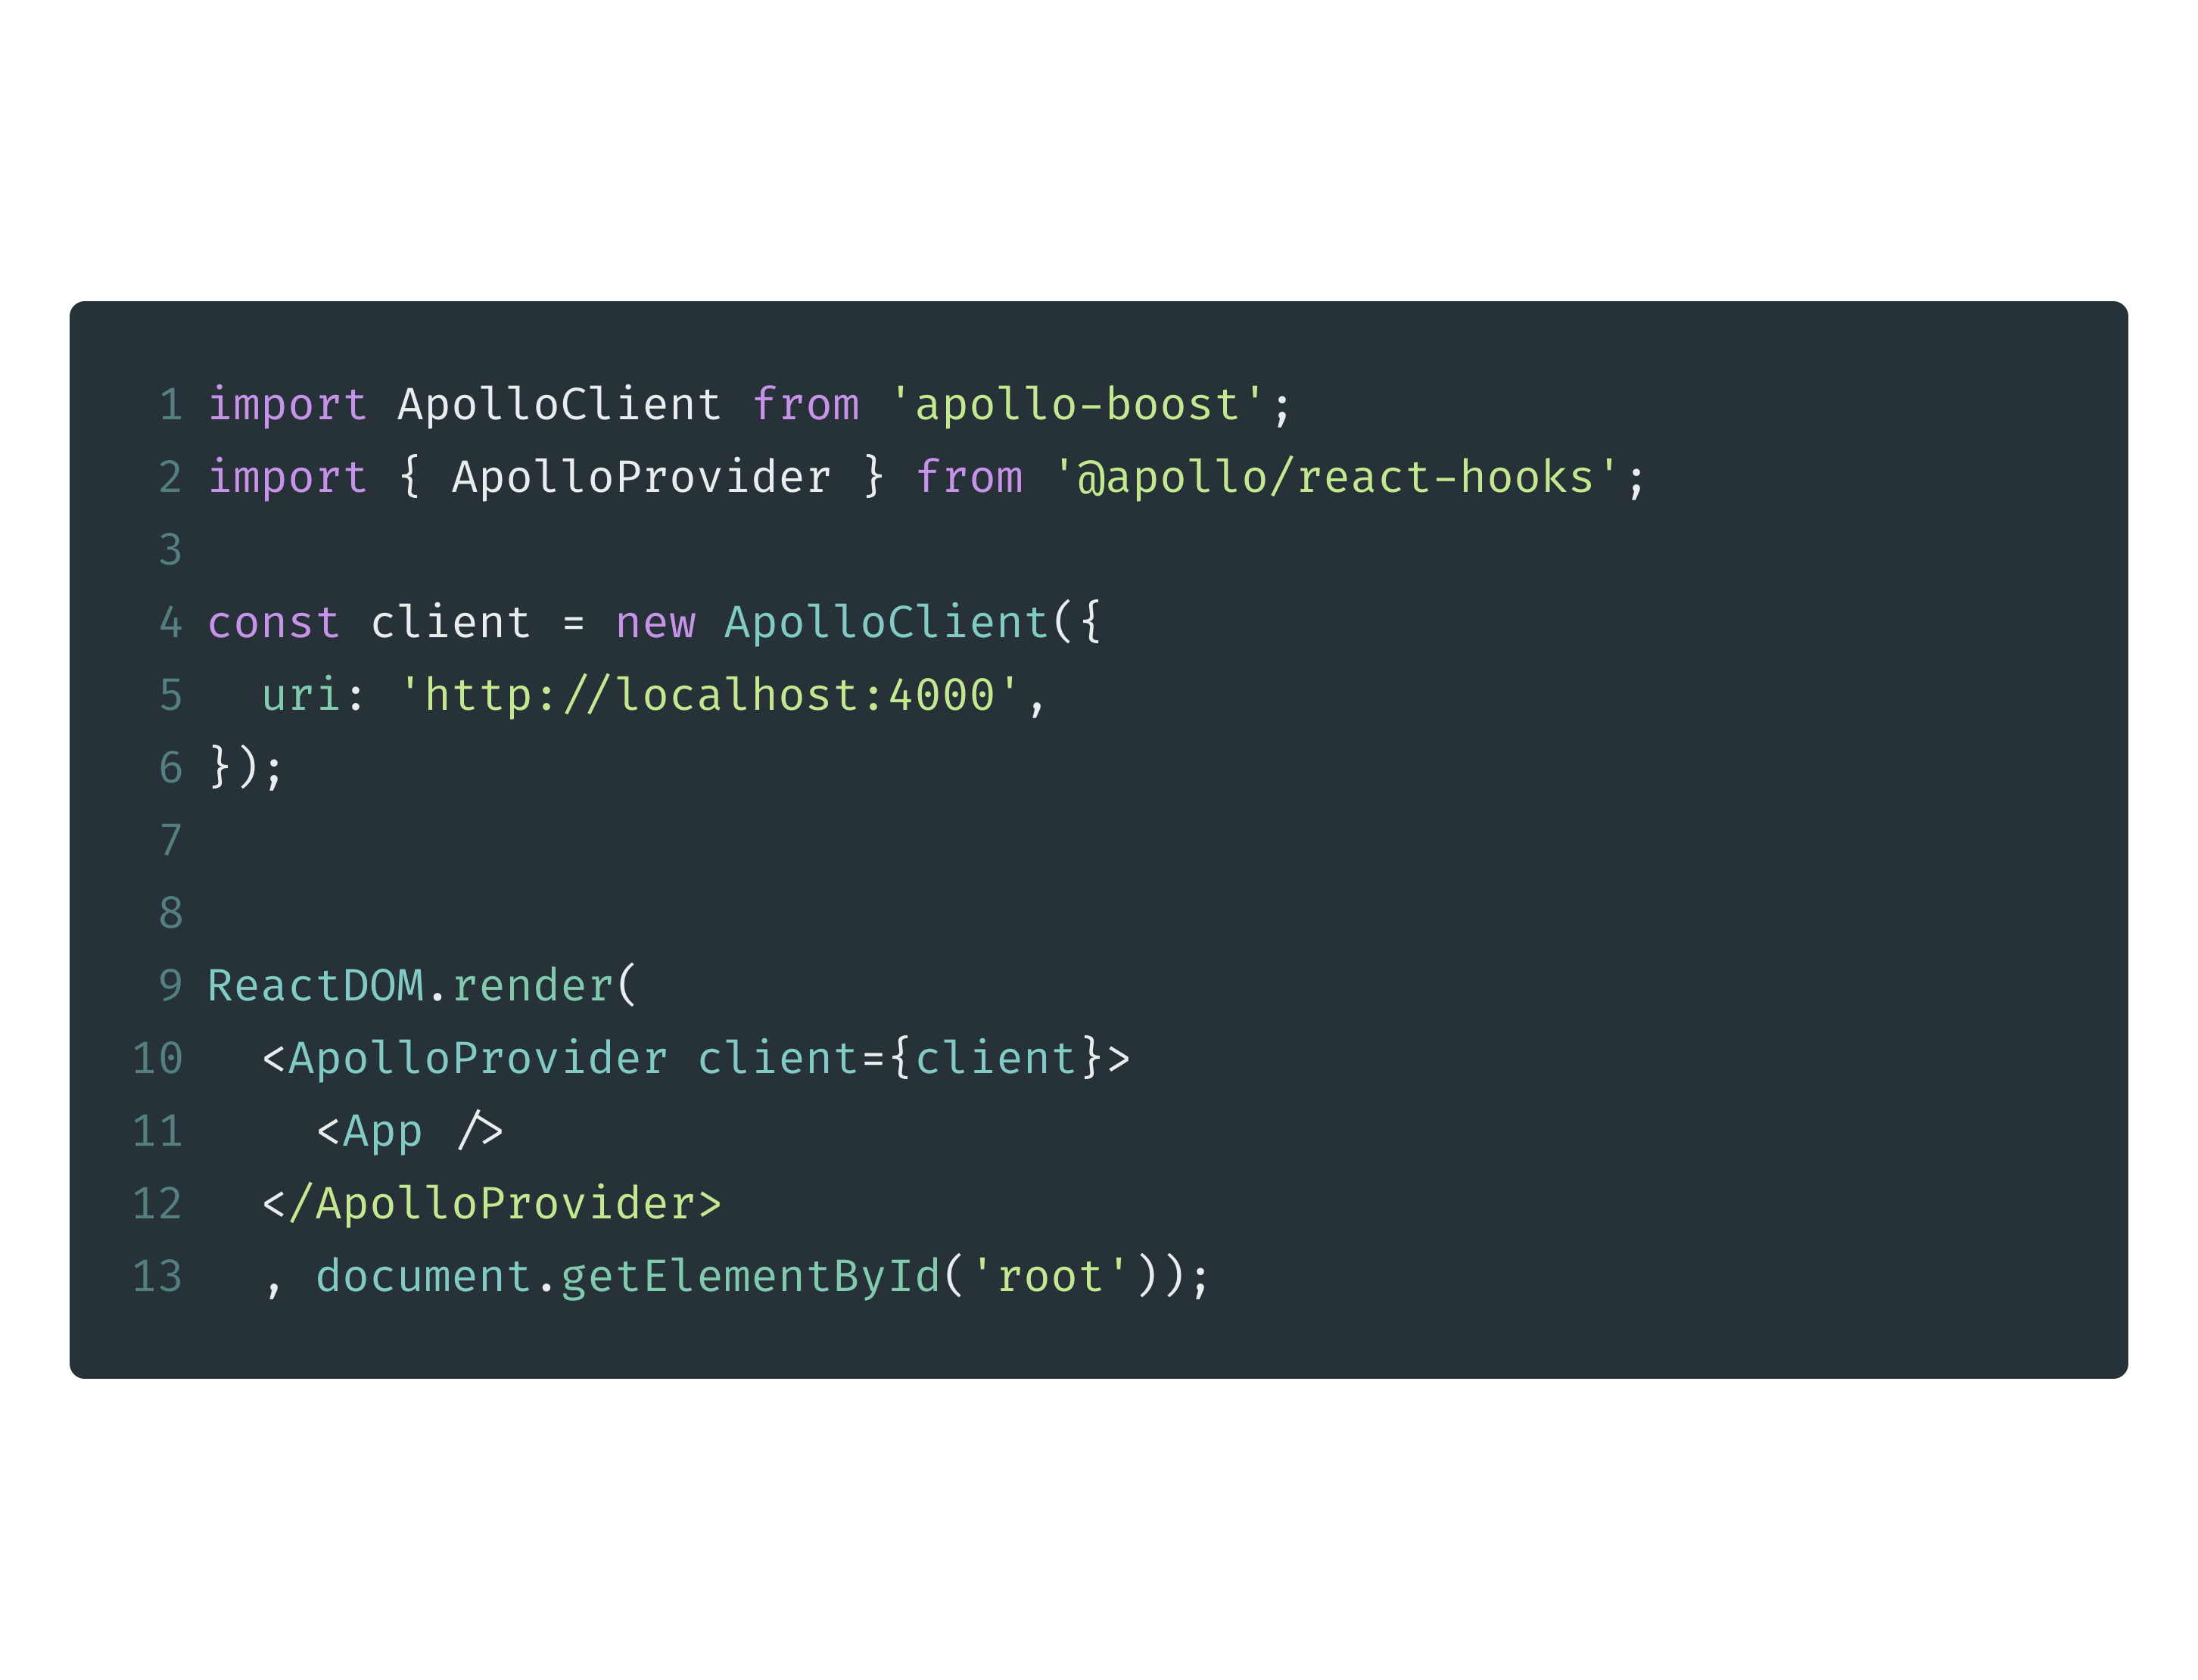
Connect your client to React

Slide 70
Workshop
Query & Mutation
https://gist.github.com/somprasongd/b38045984405730a020560c09f943c04

